Slide 1
Creating a Model for Youth-Driven HPV Prevention
Oregon HPV Summit
June 11, 2019

Slide 2
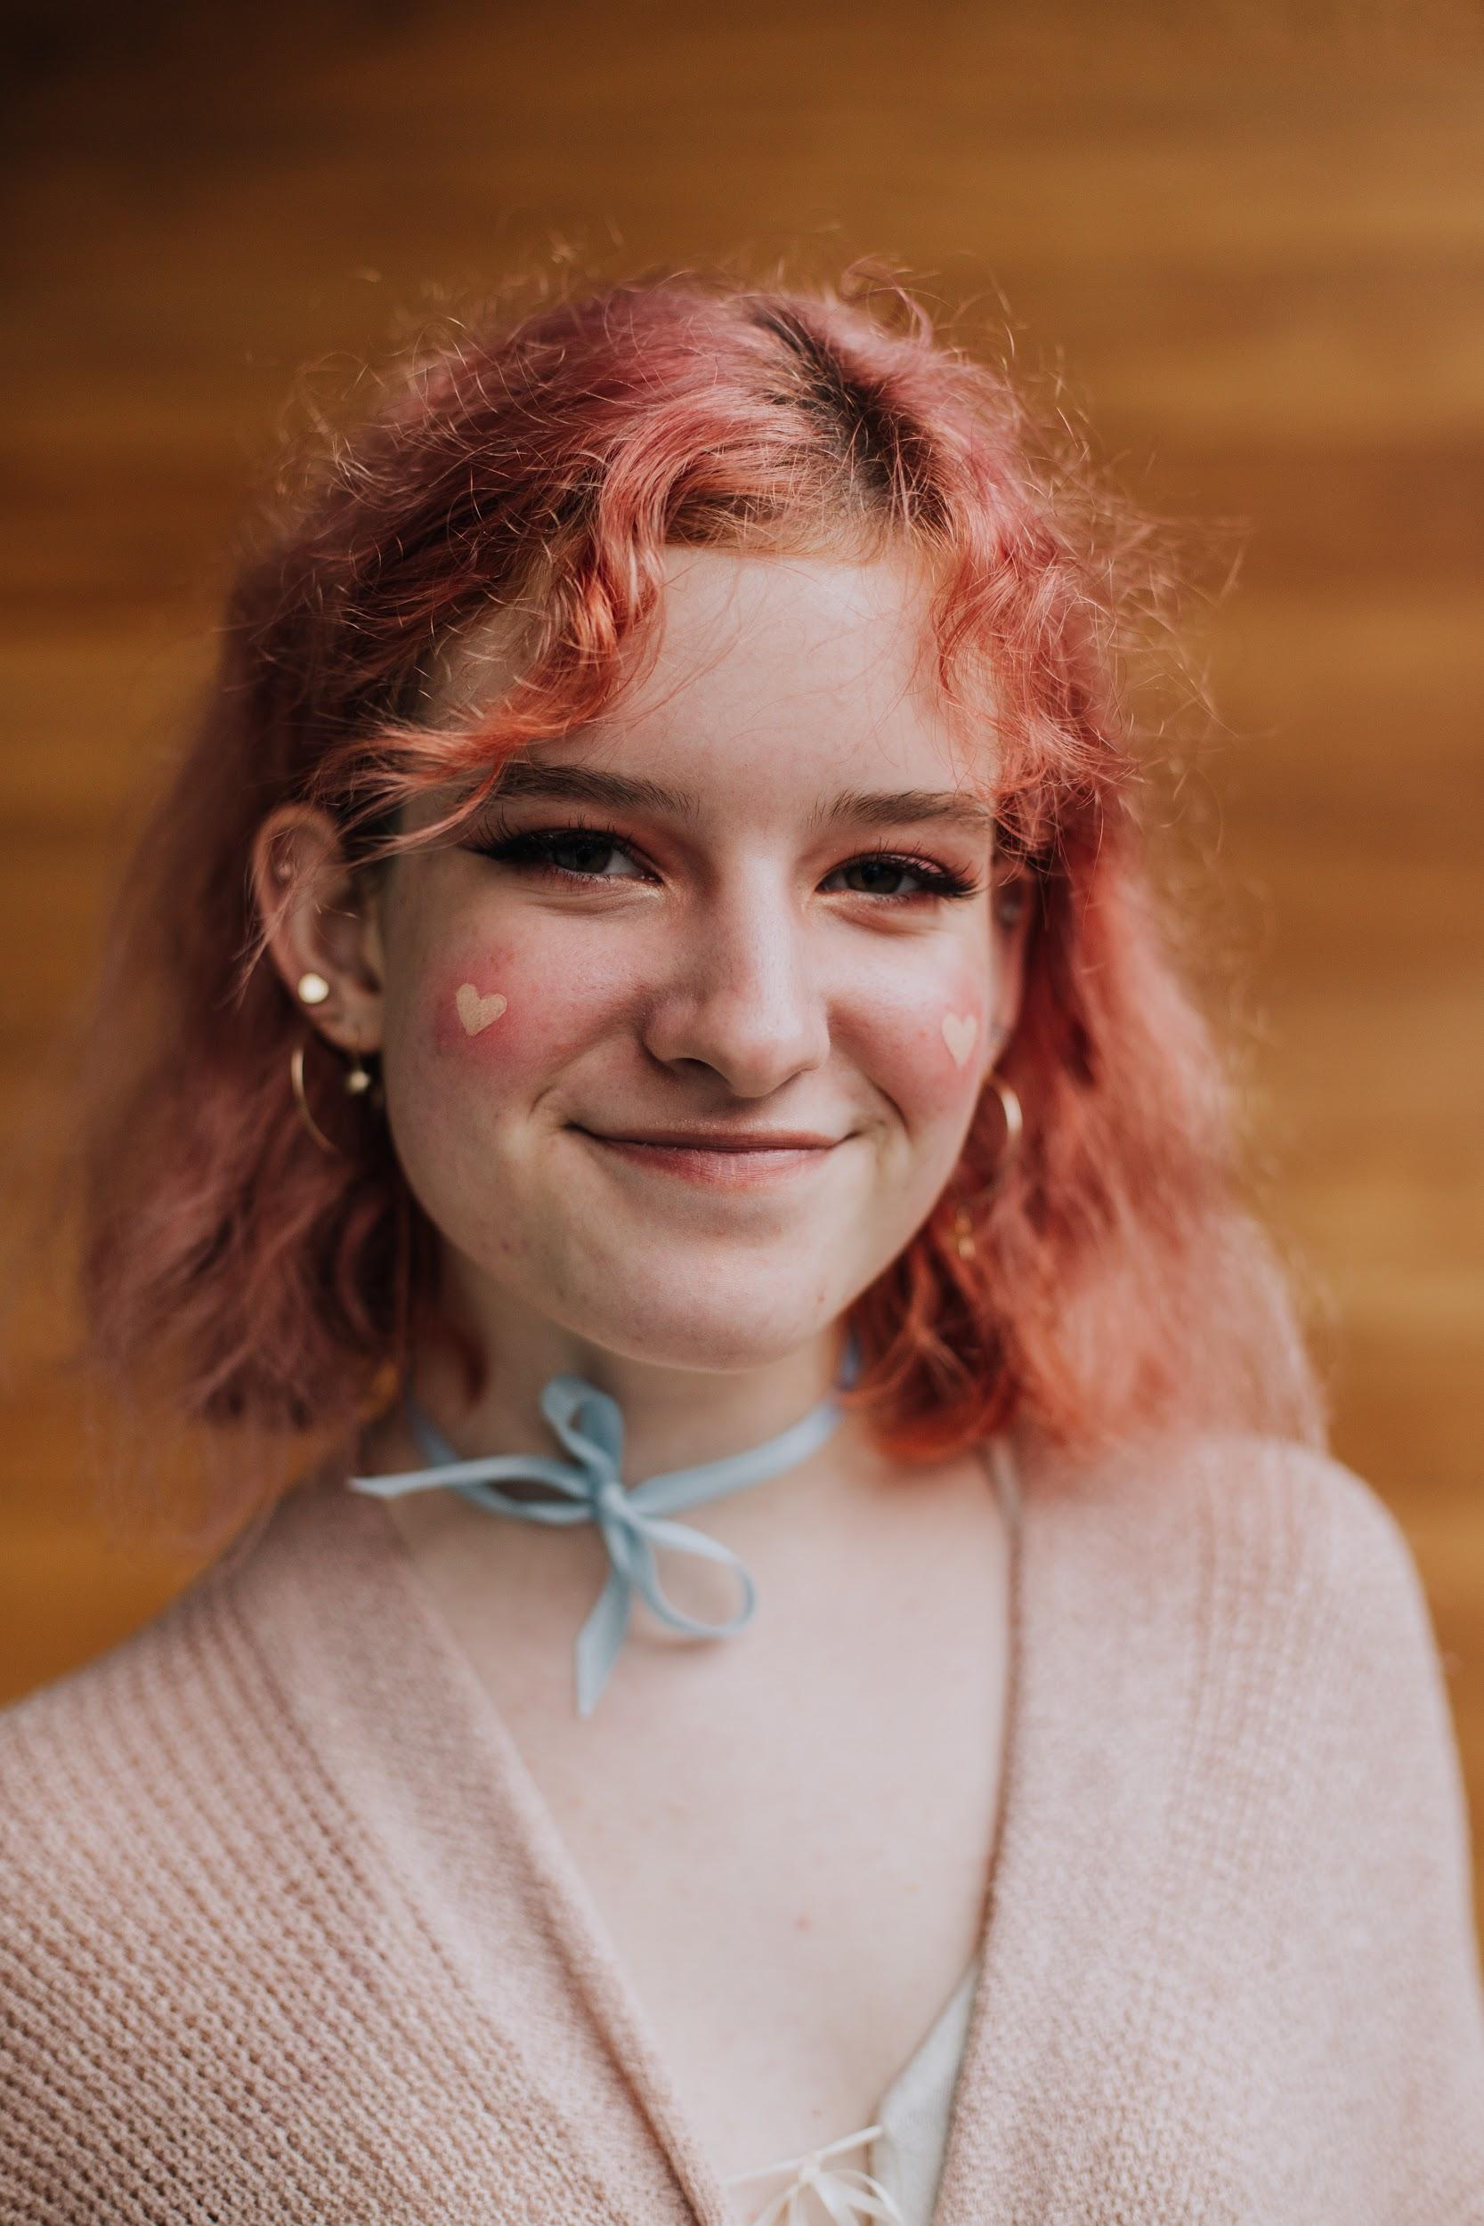
Introductions
Ashley McAllister
she/her
OSBHA Program Manager
Mira Hukill
she/her
OSBHA Student Health Advocate
HPV Youth Advisory Committee Member
Antonia Rangel-Caril
she/her
OSBHA Program and Advocacy Coordinator
Meg Feely
she/her
OSBHA Student Health Advocate
HPV Youth Advisory Committee Member
Notes:
Ashley

Slide 3
Learning Objectives
Understand youth-driven HPV prevention work happening in Oregon.
Identify common gaps in youth knowledge about HPV, and hear personal stories from youth that will highlight common misconceptions about HPV.
Identify important steps that providers and other adults can take to support youth in accessing the HPV vaccine.
Notes:
Ashley

Slide 4
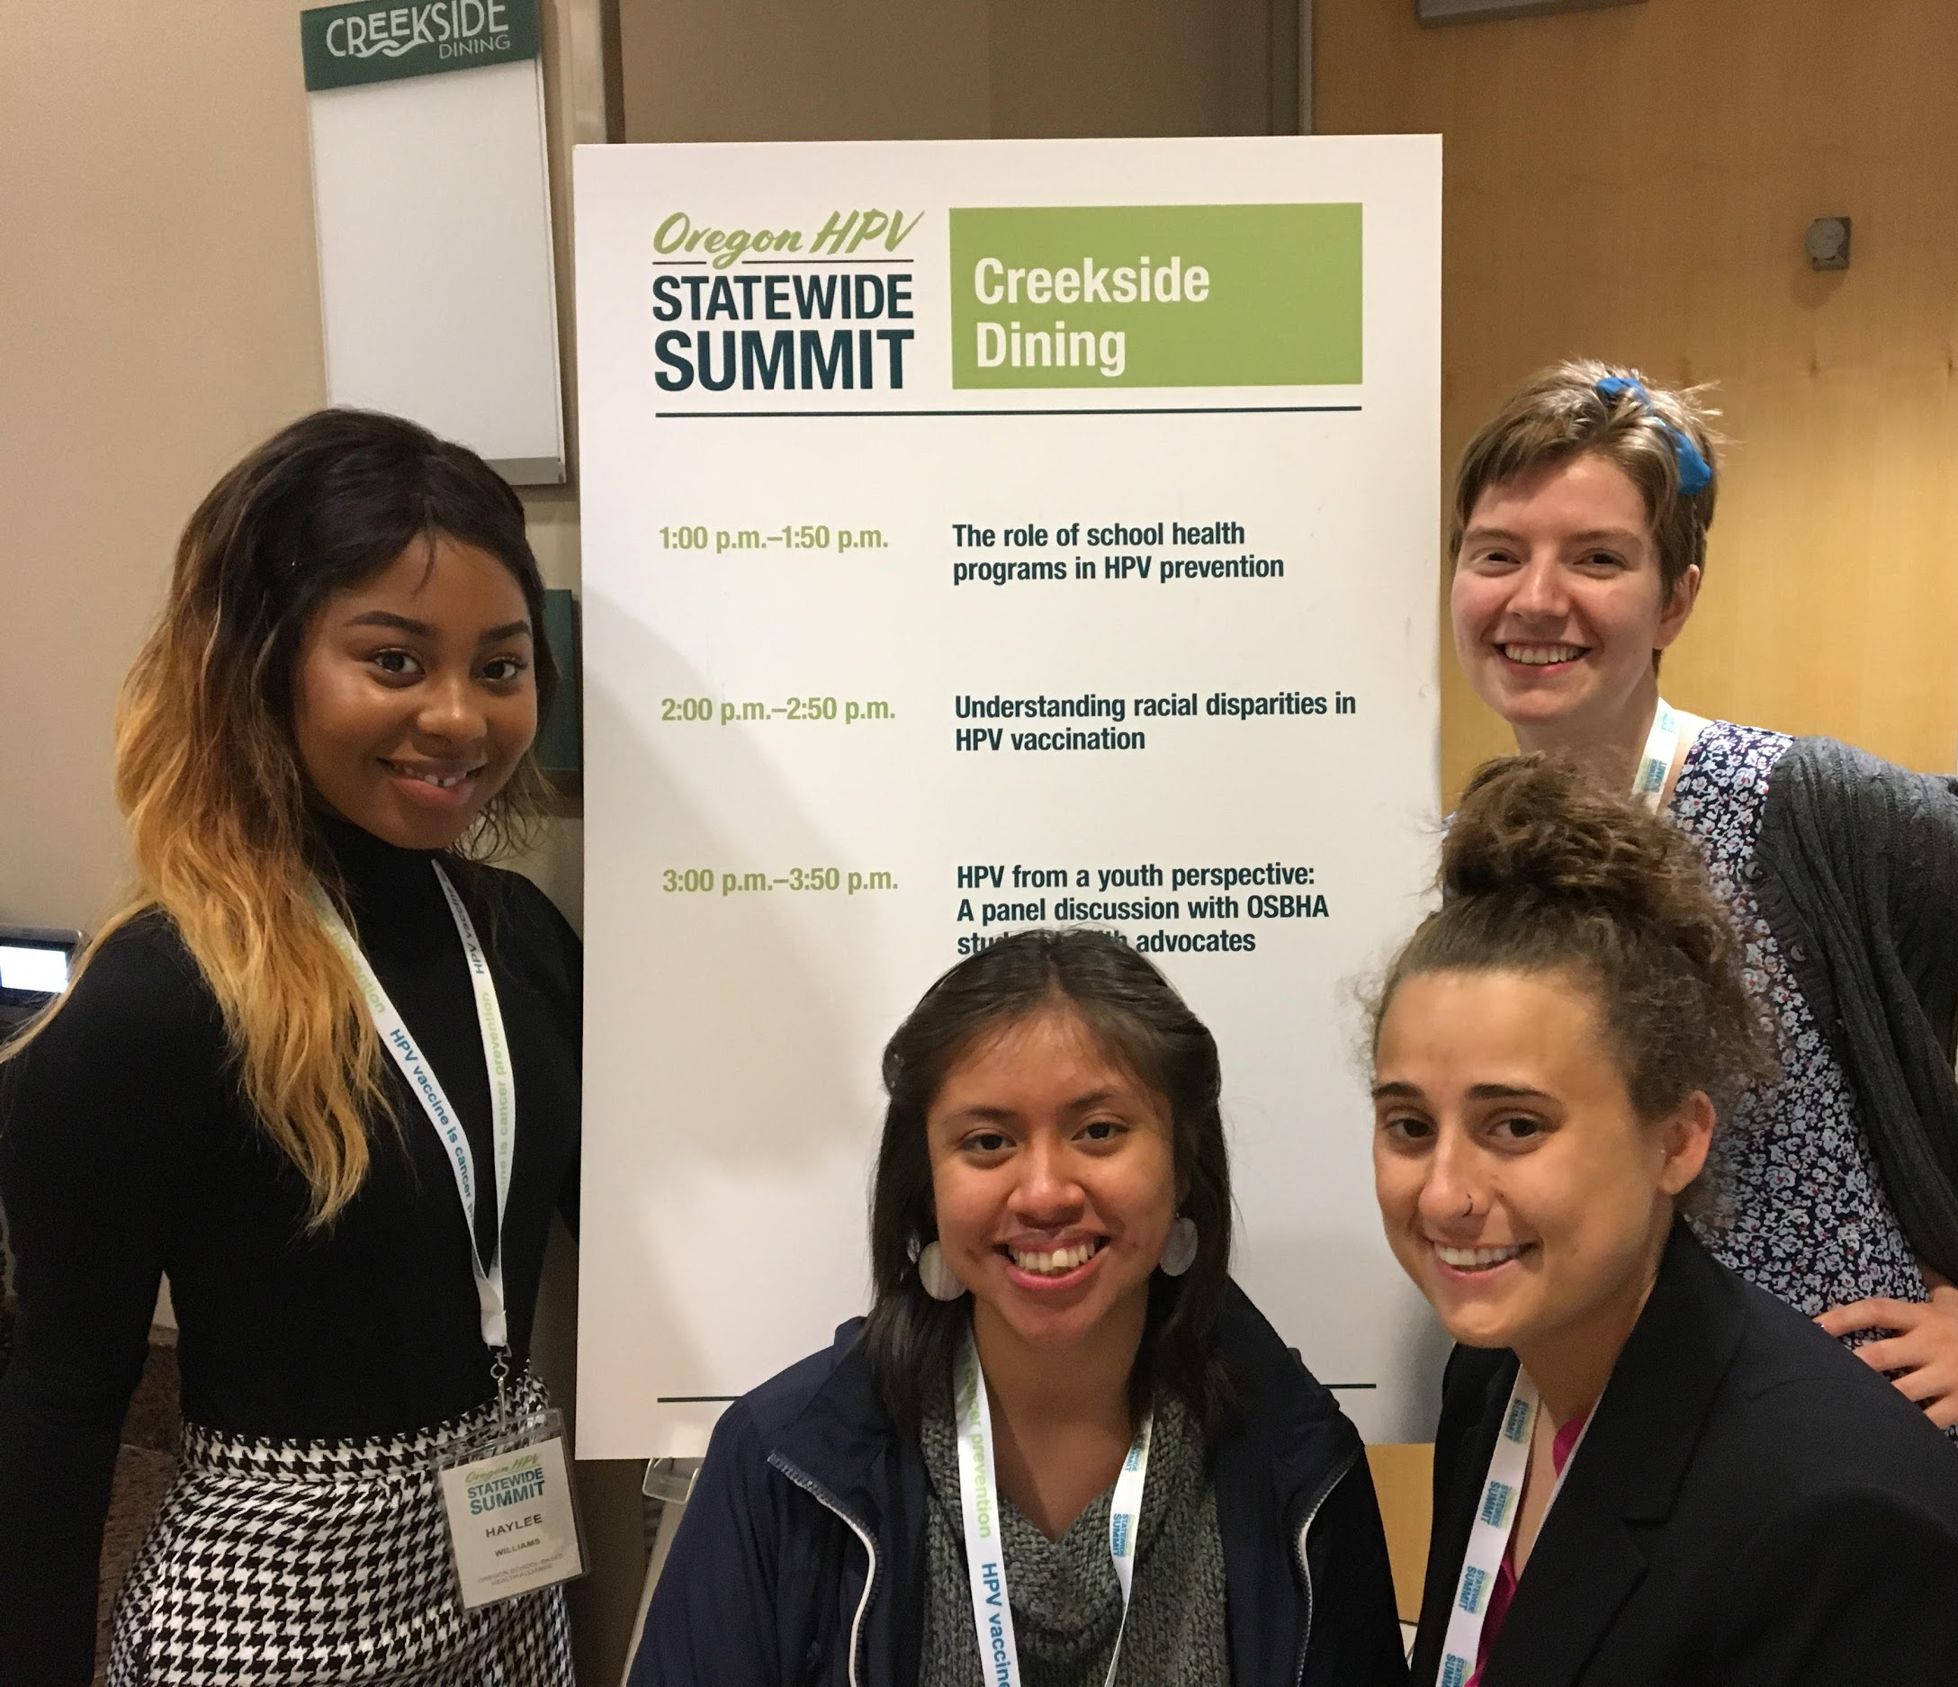
Youth-Driven HPV Prevention
Programs at OSBHA
At OSBHA, we believe youth voice is critical to healthcare programming, policy, and advocacy.
HPV Youth Advisory Committee
The committee is currently developing:
A peer-to-peer HPV prevention curriculum
A youth-led HPV prevention training for healthcare professionals
OSBHA Student Health Advocates at the 2018 Oregon HPV Summit
Notes:
Ashley -- overview of our HPV work, 10 minutes

Slide 5
Why Peer-to-Peer Education?
Peer-to-Peer Education proves to be effective through multiple studies.
Students may see peers as more credible and less judgmental.
Peers can reframe information in a “youth-friendly” way.
Empowers peer educators as well as youth receiving education.
OSBHA Student Health Advocate leading a workshop at our 2019 Youth Action Council Summit
Notes:
Antonia, 5 minutes
https://www.unicef.org/lifeskills/index_12078.html
https://www.ncbi.nlm.nih.gov/pmc/articles/PMC4499060/
http://mypeer.org.au/planning/what-are-peer-based-programs/benefits/#credible
http://www.peersdom.com/benefits-of-peer-to-peer-learning/

Slide 6
Why Don’t Youth Know About HPV?
There is no mandatory HPV prevention education for students in Oregon.
Assumed knowledge transfer from parent to youth.
Access to effective resources.
Notes:
Meg, 10 minutes
There is no mandatory HPV prevention education for students in Oregon.
Lack of knowledge transfer from parent to child, and youth don’t always know if they have been vaccinated - child got vaccinated? medical records! In a recent survey, we were surprised to find that most high school students in two Portland high schools didn’t know if they have received the HPV vaccine. It would be important for providers to let youth know that if they aren’t sure that they’ve received it, it’s important to be vaccinated again
Lack of access to effective resources.

Slide 7
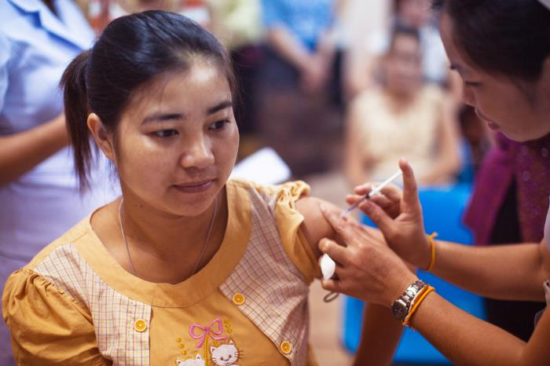
Youth experience with HPV vaccination & education
https://phil.cdc.gov/Details.aspx?pid=20882
Notes:
Mira and Meg, 10 minutes
Outline your own personal experiences (if comfortable) or experiences of your peers that you would like to highlight, and connect back to one of the gaps identified

Slide 8
How can YOU support youth in accessing the HPV vaccine?
Make information accessible and youth-friendly.
Inform youth about their rights to consent for medical care & records.
Have empathy & hold space for youth with needle anxiety.
Encourage the HPV conversation with youth - bring the HPV Eye to Eye Training to your community!
Notes:
Mira, 10 minutes
Make information accessible and youth-friendly
Letting youth know how to access the vaccine. Don’t assume that youth know what HPV is or how it is prevented since it’s not a mandatory requirement for Oregon Sex Ed curriculum
Inform youth about their rights to consent for medical care & records. Age of confidentiality. Right to care but not confidentiality
Have empathy & hold space for youth with needle anxiety. validate fear of needles
Encourage the HPV conversation with youth - bring the HPV Eye to Eye Training to your community!

Slide 9
Q & A

Slide 10
Contact us
Mira Hukill Student Health Advocate and HPV Youth Advisory Committee Member MiraHukill02@gmail.com
Megan Feely Student Health Advocate and HPV Youth Advisory Committee Member Mefeely@pdx.edu
Ashley McAlister Program Manager at the Oregon School-Based Health Alliance Ashley@osbha.org
Antonia Rangel-Caril Program and Advocacy Coordinator at the Oregon School-Based Health Alliance
Antonia@osbha.org

