Slide 1

RAVE: The Rural Adolescent Vaccine Enterprise
Funding Agency: American Cancer Society (Award #RSG CPPB - 131717)
Project Dates: July 1, 2018 – June 30, 2023
Principal Investigators: Lyle (LJ) Fagnan & Patricia (Patty) Carney
Project Manager: Caitlin Dickinson
IRB oversight by OHSU (#18753)
ClinicalTrials.gov PRS, ID#: NCT03604393
Notes:
Laura introduces RAVE

Slide 2


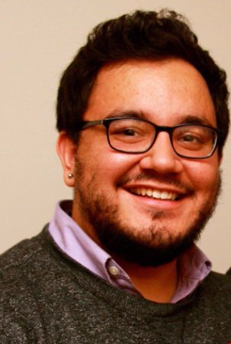
Speaking today:
Laura Ferrara, MA, CCRP
Practice Facilitator
Oregon Rural Practice-based Research Network, OHSU
Isabel Stock, BS
Practice Facilitator
Oregon Rural Practice-based Research Network, OHSU
Steele Valenzuela, MS
Biostatistician
School of Medicine, OHSU
Notes:
Laura slide

Slide 3




Project Partners
Oregon Health & Science University
  *Oregon Rural Practice-based Research Network (ORPRN)
Oregon Immunization Program- OHA
American Cancer Society
University of Oklahoma Health Sciences Center

Slide 4
Study Design
A rigorous study design to test novel interventions for increasing HPV vaccination completion in both males and females aged 11-17 years.
Baseline assessment
Aim 1
18 month clinic level intervention
Aim 2
Community-level intervention
Aim 3
Toolkit
Aim 4
Published Protocol Paper
Carney PA, Hatch B, Stock I, Dickinson C, Davis M, Marino M, Darden PM, Gunn R, Larsen R, Valenzuela S, Ferrara L, Fagnan LJ. Study Protocol for the “Rural Adolescent Vaccine Enterprise” (RAVE) Study: A Stepped-wedge Cluster Randomized Trial Designed to Improve Completion of HPV Vaccine Series and Reduce Missed Opportunities to Vaccinate in Rural Primary Care Practices. Implementation Science. 2019;14:30. https://doi.org/10.1186/s13012-019-0871-9
Notes:
As previously mentioned, the goal of RAVE is to determine interventions for increasing HPV vaccination completion in rural Oregon practices. To do this, we have 4 study aims:
Aim I: A baseline assessment of how rural primary care practices, public health programs, and community-based organizations are addressing completion of the HPV vaccine series. The assessment will include direct observation of workflows, validated measures of team-based care effectiveness, and practice-level knowledge of HPV and current HPV vaccine recommendations.
Aim II: A stepped-wedge cluster randomized trial design, to test the effectiveness of a multi-component PCP-based intervention on completion of the HPV vaccine series and reduction in rates of missed opportunities to vaccinate. The intervention will include practice facilitation to engage clinics to redesign patient care and communication strategies to optimize HPV vaccine completion, and a practice improvement model designed to firmly establish reminder and recalls systems and standing orders.
Aim III: An evidence-based community-level intervention to study HPV vaccination uptake and completion. The PCPs that we’ll work with in Aim 2 will select a partnering community-level organization such as a Community Advisory Council (CAC), patient and family advisory group, or local public health program. Together, the clinic and community group will implement an evidence based community-level intervention designed to improve knowledge among adolescents and their parents on HPV, cancer risk, risk reduction via vaccination, and the safety and effectiveness of the vaccine series. Lastly,
Aim IV: A toolkit – shared with practices, state public health programs, and CCOs – with promising clinical and community intervention features.
The methods for this study were just published in Implementation Science for further details.
The findings from RAVE will improve HPV immunization rates across rural Oregon and will be shared across rural America.

Slide 5
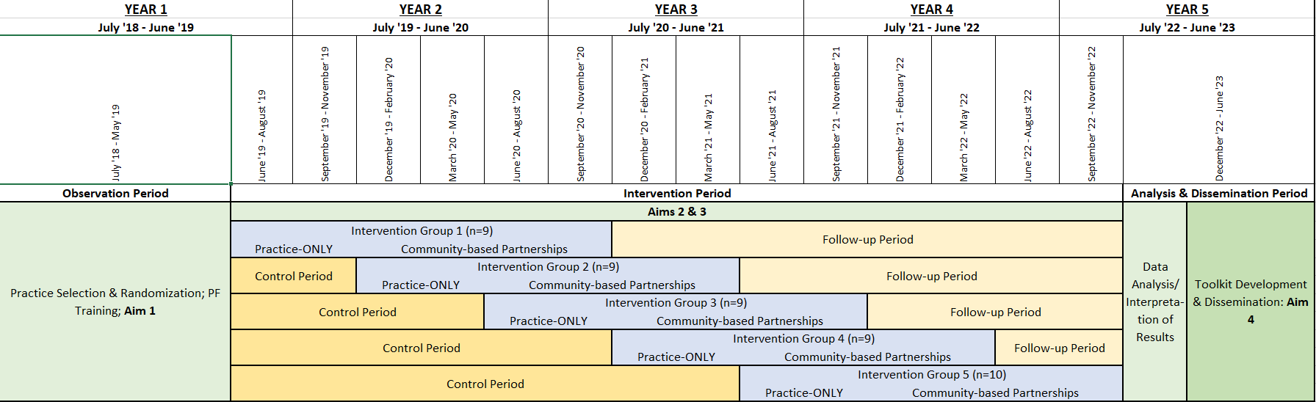
Stepped-Wedge Intervention Design
Notes:
Laura slide: here’s a more detailed time where you can see the step-wedged design. Since we are just beginning Aim’s 2 and 3 we won’t address that here so I will pass it on to Isabel who will explain Aim 1 and some key findings from there.

Slide 6
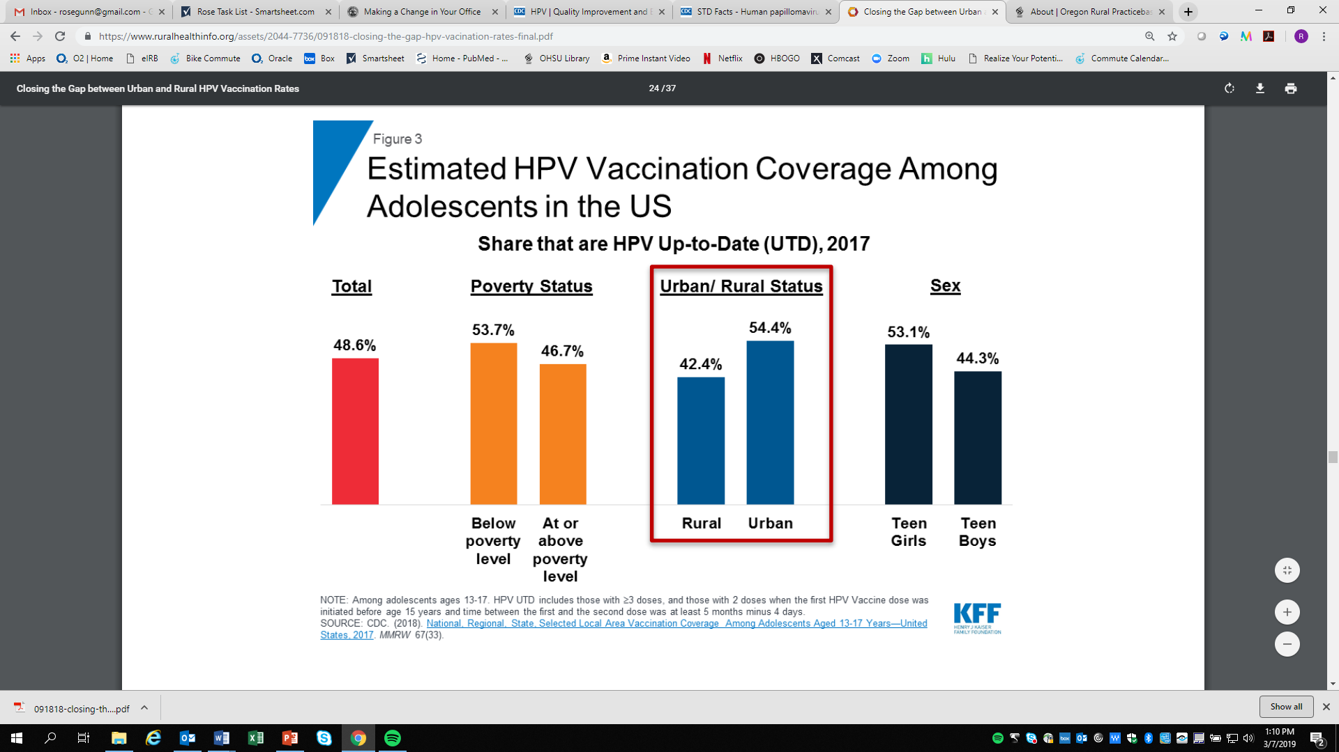
Improving Health Outcomes for Oregonians
Notes:
Laura slide: HPV vaccination is cancer prevention. The Healthy People 2020 Goal for completion of the vaccine series by age 13 to 15 years is 80%, yet only 54% of urban adolescents are vaccinated and shockingly only 42% of rural adolescents are vaccinated. Nationwide, and in Oregon, rural areas have lower vaccination rates that urban areas. Looking at year-end 2017 data, in rural Oregon, county-level completion of the HPV vaccine series is only 27.8%.
We know that rural areas have unique challenges regarding HPV and that they are understudied areas. In general, rural communities have less access to pediatricians (and some have lessa access to providers), lower health literacy, and belief systems that may prevent their community members from receiving vaccines. RAVE is special because we get to target rural areas.

Slide 7
Making the Case for RAVE
In rural Oregon, county-level completion of the HPV vaccine
series is only 27.8%.
Rural areas have unique challenges regarding HPV and are understudied
Less access to pediatricians
Lower health literacy
Belief systems
Notes:
Laura introduces the need for this work based on low rural HPV rates

Slide 8
Urban Rural Definitions
Rural Urban Commuting Area (RUCA) Codes
  Ranges from 1 – 10
    Metropolitan Area Core to Rural Areas
Oregon Office of Rural Health (ORH)
  Designate zip codes as Urban/Rural/Frontier
We honed in on RUCA Code of >=4 OR Rural/Frontier
  >= 4 is defined as a Micropolitan Area Core (10,000 to 49,999)
Possible exclusion of 43 eligible clinics if strictly using RUCA codes

Slide 9
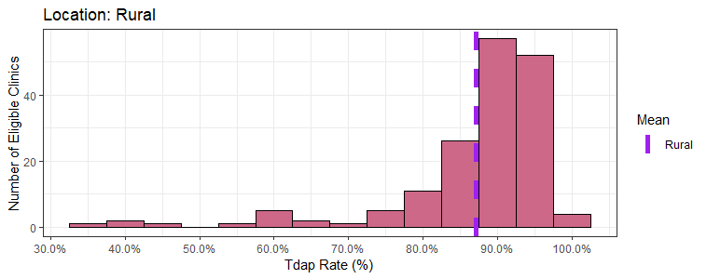
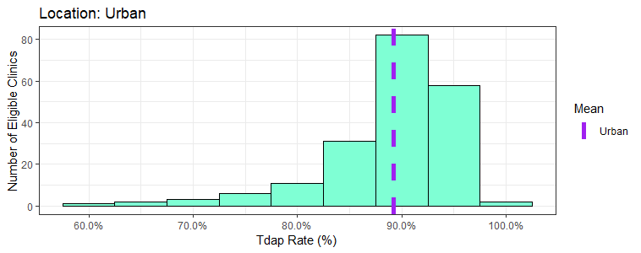
Distributions of Tdap Rates
Notes:
Same notes as previous slide.

Slide 10
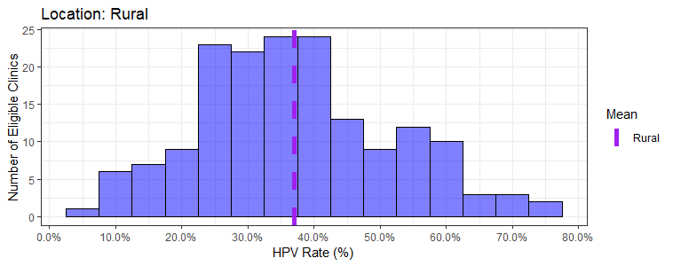
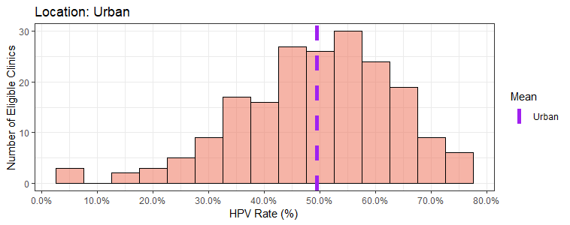
Distributions of HPV Rates
Notes:
Discuss characteristics:
Mean is less in rural areas
Rural areas are left skewed, meaning more practices scores on the lower end of the HPV rate %
Urban areas are more right skewed and have a higher mean

Slide 11
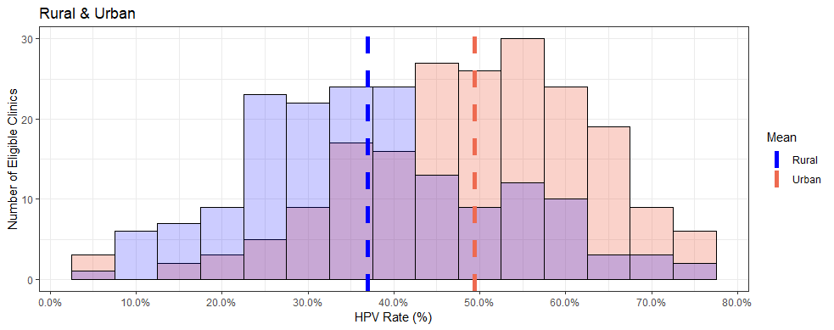
Distributions of HPV Rates
Notes:
Discuss characteristics:
Mean is less in rural areas
Rural areas are left skewed, meaning more practices scores on the lower end of the HPV rate %
Urban areas are more right skewed and have a higher mean

Slide 12
Comparison of Mean HPV & Tdap Rates
Mean rates were calculated using 364 eligible clinics, of which 168 (46.1%) are rural and 196 (53.9%) are urban.
Notes:
Discuss characteristics:
Mean is less in rural areas
Rural areas are left skewed, meaning more practices scores on the lower end of the HPV rate %
Urban areas are more right skewed and have a higher mean

Slide 13
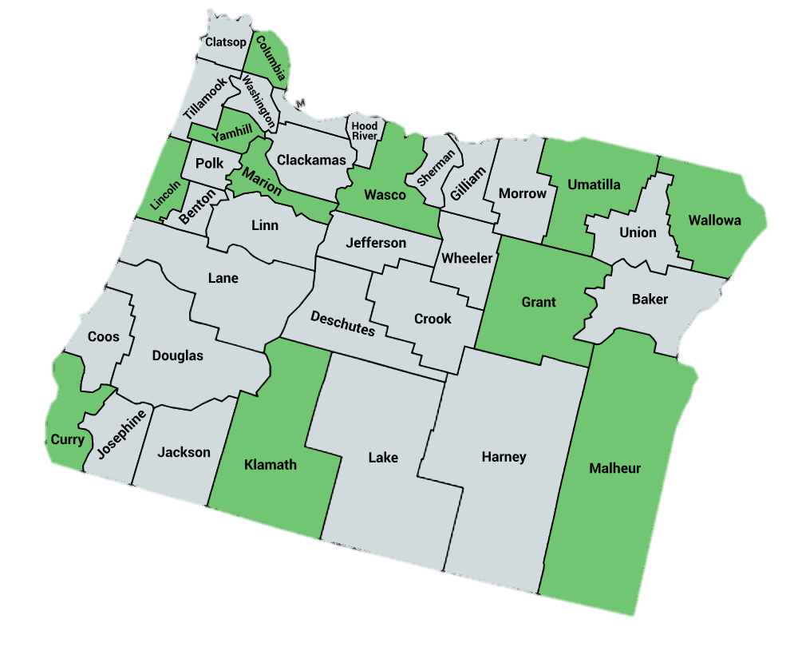
Aim 1 Design
Objective: Identify promising workflows and communication strategies with the HPV vaccine in rural clinics.
Determine variation between and within high and low performers
Qualitative observation: 12 clinics
Pediatric Clinics: 5
Family Medicine: 7
Low Performers: 4
High Performers: 8
Notes:
Isabel slide:
To improve HPV vaccination rates, we needed to get an idea of what types of workflows and conversations are happening within the clinic.
To determine variation between and within clinics that have high HPV vaccination completion rates and those that have low completion rates. Two RAVE researchers were in each clinic for a day and a half observing all aspects of patient care, from front office check in to billing, in exam rooms during patient visits, with providers and MAs at their workstations, and in the vaccine storage rooms. Basically, we went everywhere one might expect to see work around immunizations. Some providers even agreed to have informal conversations around how they view and talk about the vaccine with patients.
We observed 12 clinics across Oregon and provided etailed field notes were prepared following each observation visit and analyzed in ATLAS to draw out themes and strategies central to high rates of HPV vaccine completion. Analysis by our multidisciplinary team identified unusual but effective behaviors and strategies to boost HPV vaccine completion rates.

Slide 14
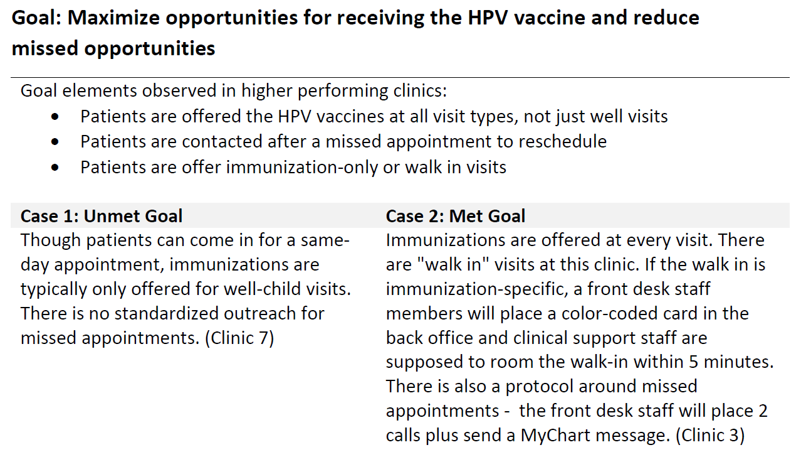
Aim 1: Early Findings
High Performing Clinics
Vaccinate at every opportunity
Effectively recommend the vaccine
Utilize ALERT or EHR to bring patients to the clinic
Example:
Notes:
Isabel Slide:
A number of key behaviors have emerged from our observations, and I’d like to highlight a few today. We plan to publish these findings, and we can share our work with you.
Convert acute visits to well child visits
Vaccinate at every opportunity
Effective provider recommendation
Active listening and motivational interviewing
Recommending vaccine at every visit to everyone helps
Recommend early
Patient outreach
Utilizing ALERT or EHR to bring patient to clinic for initial or completion
There are a lot of “extra steps” or multiple ways for recording or entering vaccine-related data: superbills, sticky notes, entering on multiple tabs within the EHR, etc.
Some EHR systems are better than others in terms of viewing patients’ records, linking with scheduling and billing systems, and running reports
(TYPE MORE)

Slide 15
Aim 1: Early Findings
Improvements…
Ensure all clinical staff are comfortable answering questions about the vaccine
Confirm EHR and ALERT data are reliable
  Utilize bi-directional data exchange
  Document vaccine refusals
Reduce missed opportunities to vaccinate
  Offer the vaccine at every encounter
  Offer vaccine-only and walk-in visits
  Contact patients if they missed an appointment
Notes:
Isabel slides
HPV immunization recommended appropriately by care team. This means introducing the HPV vaccine in the same way as all other vaccines and relaying the information that the vaccine prevents certain types of cancer in both males and females. Having educational materials OTHER THAN the VIS
Bi-directional exchange: Most clinics have it that their EHR sends the data to ALERT. Bi-directional has ALERT send data back, I.e. if the child received a vaccine at another clinic that submits data to ALERT, it would be reconciled in the patients chart in the EHR.
Contacting patients that missed any type of appointment. Offer walk in immunizations and make it a good experience!

Slide 16
Aim 1: Early Findings
Improvements…
Conduct population outreach
  Generate reports
Schedule follow-up dose(s) before the patient leaves the clinic
Engage in community awareness activities
  Work with schools
  Work with public health
  Educate your community
Promote a pro-vaccine culture
Notes:
Isabel slide:
Reports can show you if a patient needs a well child check which provides an opportunity to vaccinate. They can also show you who has initiated the vaccine and needs to scheduled for the 2nd dose. Have staff call, mail a letter (ALERT can do this), electronic message to patient portal. Doing this every month makes it fast and consistent, ad-hoc can be very painful which large lists of patients to contact.
List reports will become smaller the better we do at scheduling that follow up visit on an immunization walk-in visit 6 months out.
Have a vaccine champion and create time in their schedules to conduct this work, ensure you are hiring employees at all levels that support vaccines. Share immunization rates with all staff and create good-natured healthy competition!

Slide 17
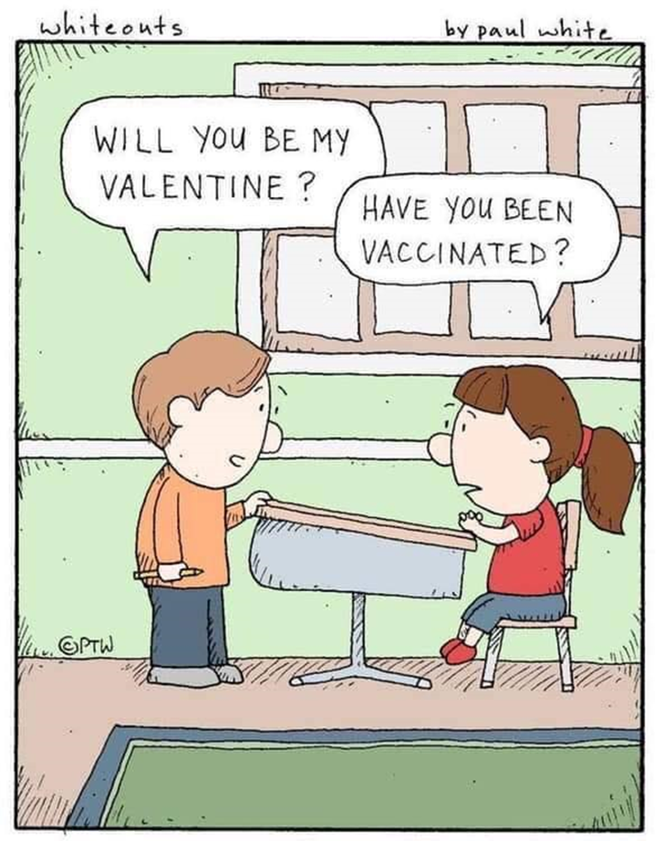
Next Steps
Finalize Aim 1 analyses & publish findings
*Launch Aim 2 in June 2019
Begin work with communities in December 2019 (Aim 3)
Craft toolkit throughout year 2 (Aim 4)
Baseline assessment
Aim 1
18 month clinic level intervention
Aim 2
Community-level intervention
Aim 3
Toolkit
Aim 4
Notes:
What comes next? Well, we’re less than a year into this 5 year study, so we’re just getting started.
In the very near future, we plan to finalize our aim 1 analyzes and publish our findings. This month, we get to kickoff aim 2 with 9 clinics. We’ll begin working with communities for Aim 3 in December, and we’ll work on our Aim 4 toolkit throughout the second year of the study. We have a lot of work ahead of us, but the RAVE team is quite excited to be doing this work! Thank you!

Slide 18
Thank you!
Questions?
RAVE@ohsu.edu

