Slide 1


Surveillance of HPV-related cervical pre-cancers (CIN2+) in Oregon
2008-2017
Oregon HPV Summit - June 2019
Nasreen Abdullah, MD, MPH
Sara Ehlers, MPH

Slide 2
Outline of Presentation
Describe Surveillance System of cervical precancers
Preliminary findings
  HPV-related cervical disease in Oregon, 2008-2017
  Pap screening estimates
  Prevalence and distribution of HPV types

Slide 3
Surveillance
Surveillance System
Methods

Slide 4
Surveillance Objectives
Estimate incidence of high-grade cervical dysplasia and monitor trends
Monitor prevalence and distribution of HPV types
Describe CIN 2+ patient characteristics
Estimate cervical cancer screening
Estimate vaccine effectiveness

Slide 5
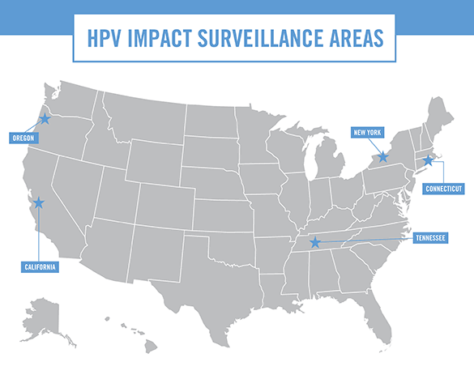

Slide 6
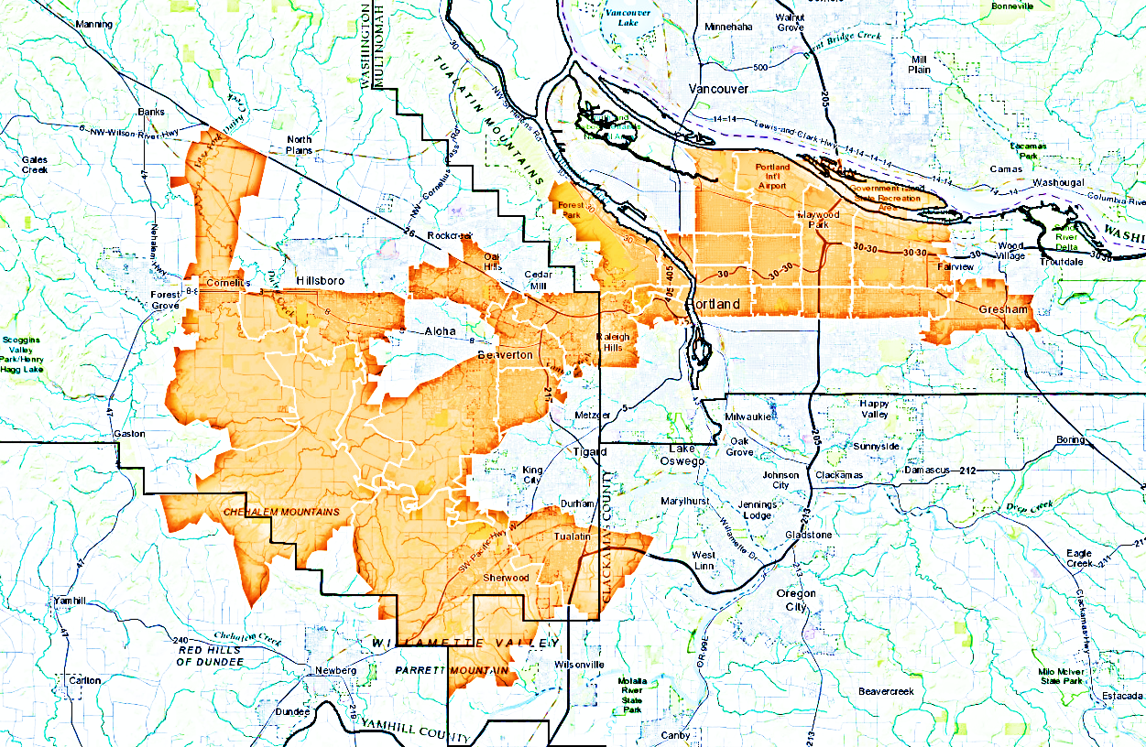
Surveillance Methods – Case Definition
Woman >18 years
Resident of 28 zip code area
Biopsy confirmed diagnosis of CIN 2+
Incident diagnosis on or after January 1, 2008

Slide 7
Surveillance Methods – Data Sources
Data Sources
  - Pathology reports from the labs
  Providers and electronic medical records
  Immunization registry (ALERT)
Specimens – HPV Typing

Slide 8
Methods: HPV Type Testing
Vaccine | 6 | 11 | 16 | 18 | 31 | 33 | 45 | 52 | 58
HPV 2 |  |  | X | X
HPV 4 | X | X | X | X
HPV 9 | X | X | X | X | X | X | X | X | X
Genital warts
~70% of cervical cancers
~15% of cervical cancers

Slide 9
Why monitor precancers
Assess vaccine effectiveness
  Dysplasia as proxy for cervical cancer
Precancers themselves cost millions for evaluation and treatment

Slide 10
Data Results
Incidence of cervical precancers

Slide 11
Incidence Rate of CIN 2+ Cases, by Age Group, 18-39 Years, Portland Area, 2008-2017
*Data are provisional and not for publication.

Slide 12
Percentage of Women who Received a Pap Screening, by Age Group, 18-39 Years, Portland Area, 2008-2017
*Data are provisional and not for publication.

Slide 13
CIN2+ Incidence Rate among Screened Women Aged 18-24 Years, Portland Area, 2008-2017
*Data are provisional and not for publication.

Slide 14
Incidence Rate of CIN 2+ Among Screened Women Aged 25-39 Years, Portland Area, 2008-2017
*Data are provisional and not for publication.

Slide 15
Incidence Rate of CIN 2+, Women Aged 20-64 Years, by Race/Ethnicity, 2008-2016
*Data are provisional and not for publication.

Slide 16
Asian vs. Other Groups - Median Age at Incident CIN 2+ Diagnosis, 20-64 years, 2008-2016
Race/ethnicity | Number | Median age | P-value
Asian | 227 | 34 | N/A
Black | 157 | 29 | <0.0001
Hispanic | 437 | 32 | 0.0049
White | 3226 | 31 | <0.0001
*Data are provisional and not for publication.

Slide 17
Relative Percentage of CIN 2+ Grades by Race/Ethnicity, Portland Area, 2008-2017
*Data are provisional and not for publication.

Slide 18
Summary
The percentage of women receiving Pap smears declined
For women aged 18-24 years:
  CIN 2+ rate declined
  CIN 2+ rate for screened women declined
For women 25-39 years:
  CIN 2+ rate remained same or increased
  CIN 2+ rate for screened women increased
There are differences by race/ethnicity groups
CONCLUSION: CIN 2+ incidence has decreased in the cohorts of women that include vaccine recipients.

Slide 19
Data Results
Prevalence & distribution of HPV Types

Slide 20
Number of women Aged 18-39 Years with HPV typed CIN 2+, by Age Group and HPV Vaccination Status, Portland Area, 2008–2016
*Data are provisional and not for publication.

Slide 21
Percentage of HPV Types by Vaccination Status for Women Aged 18-39 Years with CIN 2+, Portland Area, 2008–2016
Vaccinated:
*Data are provisional and not for publication.

Slide 22
Percent HPV Types by Race/Ethnicity, CIN2+ Cases in Women Aged 18-39 years, Portland Area, 2008–2016
*Data are provisional and not for publication.

Slide 23
Summary of Oregon HPV Typing Data
HPV Type distribution
  50% - 16/18
  25-30% - 6/11/31/33/45/52/58
  These pre-cancers are preventable!
HPV Type Distribution by vaccination status
  Vaccinated women less likely to have type 16/18 than unvaccinated women
  Vaccinated women more likely to have types not covered by vaccines than unvaccinated women
  Data to come for types covered by nanovalent vaccine (widely in use in 2016)

Slide 24
Conclusion
Next Steps
Conclusion

Slide 25
Conclusion
Data are confusing, but vaccine appears to be having a positive impact on CIN 2+ rates
Oregon’s data are similar to national HPV Impact 2008-2017 data
  CIN 2+ rates declined in 18-24 year old women
  The percent of women screened for cervical cancer decreased across all age groups and sites
  CIN 2+ rates declined among screened women 18-24 years old
  CIN 2+ rates increased among screened women aged 25-39

Slide 26
THANK YOU!
Project Coordinator and Epidemiologist:
Nasreen Abdullah, MD, MPH: nasreen.abdullah@state.or.us
Research Analyst:
Sara Ehlers, MPH: sara.j.ehlers@state.or.us
PSET, Informatics & HPV Manager:
Melissa Powell, MPH: melissa.e.powell@state.or.us

