Slide 1
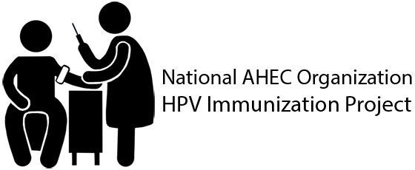
You are the Key to HPV Cancer Prevention Understanding the Burden of HPV Disease, the Importance of the HPV Vaccine Recommendation, and Communicating about HPV Vaccination
Presented by:
Michelle Berlin, MD, MPH
Director, OHSU Center for Women’s Health
Vice Chair, Dept of Obstetrics and Gynecology
Oregon Health & Science University
Funding for this presentation was made possible by the Centers for Disease Control and Prevention Grant No. 1H23IP000960-01 to the National AHEC Organization. The views expressed in written conference materials or publications and by speakers and moderators do not necessarily reflect the official policies of the Department of Health and Human Services, nor does the mention of trade names, commercial practices or organizations imply endorsement by the U.S. Government.

Slide 2
Disclosure Information PPMC Medical Grand Rounds – October 4, 2017 Michelle Berlin, MD, MPH
Disclosure of Relevant Financial Relationships
I have no financial relationships to disclose.

Slide 3
Objectives
Describe the burden of HPV disease.
Define the importance of HPV vaccination for cancer prevention.
Explain the rationale for vaccinating youth at ages 11 or 12.
List the recommendations for administering the HPV vaccine to girls and to boys.
Provide useful and compelling information about HPV vaccine to parents to aid in making the decision to vaccinate.
Locate resources relevant to current immunization practice.
Notes:
When this presentation is complete, you should be able to: one, describe the burden of HPV disease; two, define the importance of HPV vaccination for cancer prevention; three, explain the rationale for vaccinating youth at ages 11 or 12; four, list the recommendations for administering the HPV vaccine to girls; five, provide useful and compelling information about HPV vaccine to parents to aid in making the decision to vaccinate; and finally, locate resources relevant to current immunization practice.

Slide 4
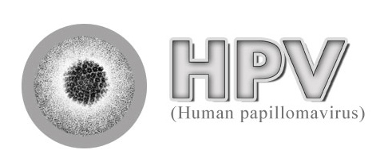
HPV Infection & Disease
Understanding the Burden
Notes:
The first section will focus on HPV infection and disease prevalence.

Slide 5
HPV Types Differ in their Disease Associations
~40 Types
Mucosal
sites of infection
Cutaneous
sites of infection
~ 80 Types
High risk (oncogenic) HPV 16, 18 most common
Low risk (non-oncogenic) HPV 6, 11 most common
Cancer Precursors
Cancer
Genital Warts
Laryngeal Papillomas
“Common” Hand and Foot
Warts
Notes:
Human papillomaviruses (HPV) are a very common family of viruses that infect epithelial tissue. HPV types differ in their tendency to infect cutaneous and mucosal or genital epithelium. More than 150 HPV types have been identified, including approximately 40 that infect the genital area. Genital HPV types are categorized according to their epidemiologic association with cervical cancer. High-risk types (e.g., types 16 and 18) can cause low-grade cervical cell abnormalities, high-grade cervical cell abnormalities that are precursors to cancer, and cancers. In addition to cervical cancer, HPV infection also is the cause of some cancers of the vulva, vagina, penis, and anus, as well as cancer of the oropharynx. Low-risk types like 6 and 11 can cause benign or low-grade cervical cell changes, genital warts, and recurrent respiratory papillomatosis.

Slide 6
HPV Infection
Most females and males will be infected with at least one type of mucosal HPV at some point in their lives
Estimated 79 million Americans currently infected
14 million new infections/year in the US
HPV infection is most common in people in their teens and early 20s
Most people will never know that they have been infected
Satterwhite et al. Sex Transm Dis. 2013
Notes:
Most HPV infections happen during the teen and college-aged years because HPV infection usually occurs soon after sexual debut. Most people never know that they have been infected. Women may find out they are infected because of an abnormal pap test with a positive HPV test or a diagnosis of genital warts. Men may find out because of a genital warts diagnosis as well.

Slide 7
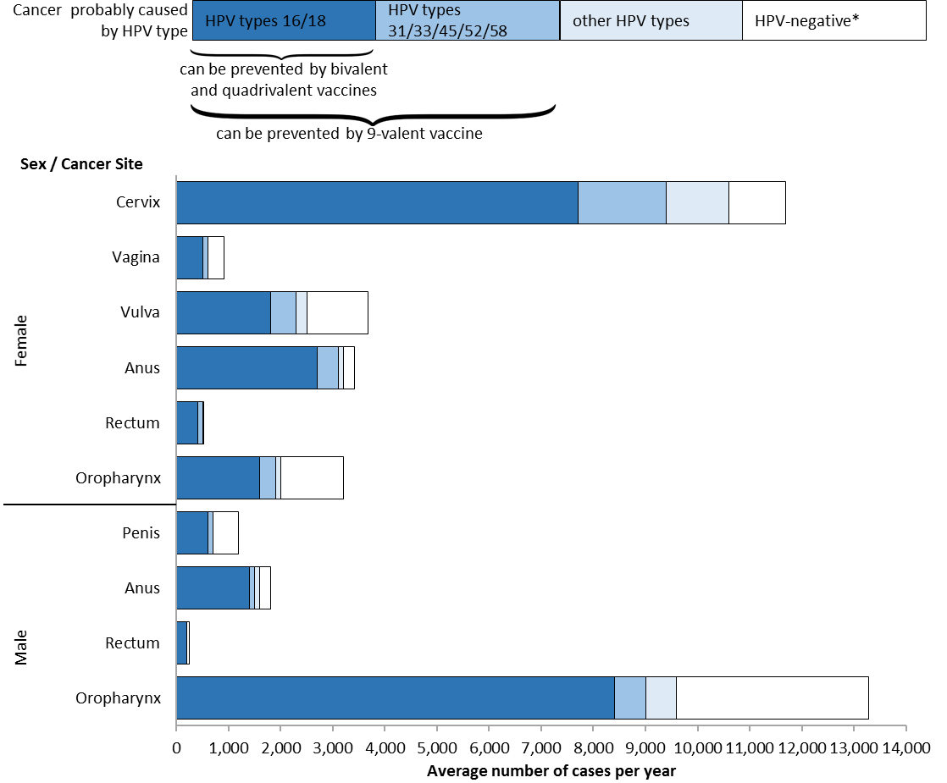
HPV-Associated Cancers per Year, United States, 2009–2013
Based on Viens et al. MMWR 2016. https://www.cdc.gov/cancer/hpv/statistics
Notes:
This slide shows the number of HPV-Associated Cancer cases that were diagnosed and reported each year in United States from 2009 to 2013 (the most recent 5-year period with available data).
Cancer registries do not routinely collect data on whether HPV is in the cancer tissue. So, to estimate the number of HPV-associated cancers, researchers look at cancer in parts of the body and cancer cell types that are likely to be caused by HPV. These parts of the body include the cervix, vagina, and vulva among women; the penis among men; and the anus, rectum, and oropharynx, which is the back of the throat, including the base of the tongue and the tonsils. The cellular types include carcinomas of the cervix and squamous cell carcinomas of the vagina, vulva, penis, anus, rectum, and oropharynx. Additionally, in this analysis, all cancers were microscopically confirmed.
A CDC study published in 2016 used population-based data to genotype HPV types from cancer tissue. These data are used to estimate the percentage of these cancers that are probably caused by HPV, what we call HPV-attributable cancers.
This graph shows the total number of HPV-associated cancers and uses the attributable fractions from the genotyping study to estimate the number probably caused by HPV types. HPV types were grouped as 16/18 (the dark blue bar), other high risk types 31/33/45/52/58 (the medium blue bar), and other HPV types (light blue bar). The white bar means that HPV DNA was not detected.

Slide 8
New Cancers Caused by HPV per Year United States 2006-2010
Vulva n=2,200 13%
Penis n=700 8%
Vagina n=600 3%
Anus n=2,600 15%
Anus n=1,400 15%
Oropharynx n=1,800 10%
Cervix n=10,400 59%
Oropharynx n=7,200 77%
Women (n = 17,600)
Men (n = 9,300)
CDC, United States Cancer Statistics (USCS), 2006-2010
Notes:
Persistant HPV infection can cause cancer in both men and women. HPV infection can cause cervical, vaginal, and vulvar cancers in women and penile cancer in men. HPV can also cause anal cancer, mouth/throat (oropharyngeal) cancer, and genital warts in both men and women. Nearly 18,000 women in the United States are diagnosed with a cancer caused by HPV each year. There are more than 9,000 HPV cancers diagnosed in U.S. men each year so 27,000 total
1 case every 20 min
Breakdown of HPV cancers in men and women

Slide 9
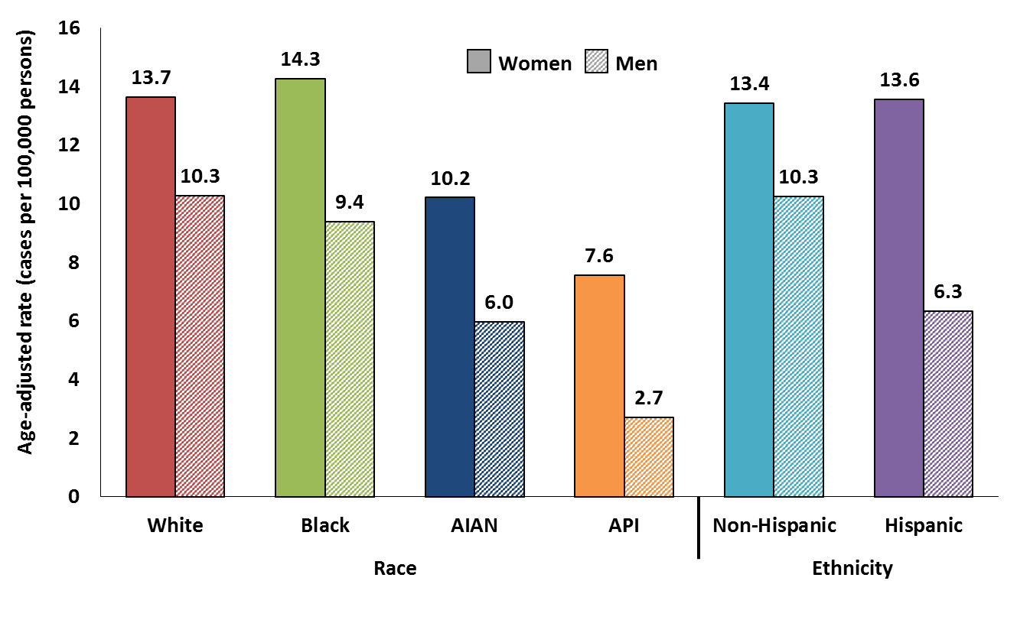
HPV-Associated Cancer Rates by Sex, Race and Ethnicity, United States, 2009–2013
Based on Viens et al. MMWR 2016. https://www.cdc.gov/cancer/hpv/statistics
Notes:
This graph shows the incidence of all HPV-associated cancers (all carcinomas of the cervix and squamous cell carcinomas of the vagina, vulva, penis, anus, rectum, and oropharynx) by sex, race and ethnicity. “Incidence rate” means how many people out of a given number get the disease each year. Incidence rates of HPV-associated cancers varied by sex and race or ethnic group. The rate for women is shown in the solid bar and the rate for men is shown in the hatched bar.
In each race/ethnic group, women had higher rates than men (because of cervical cancer).
Among women, blacks had the highest rates and Asian/Pacific Islanders had the lowest rates compared with other racial groups and Hispanics had higher rates than non-Hispanics.
Among men, whites had the highest rates and Asian/Pacific Islanders had the lowest rates compared with other racial groups and non-Hispanics had higher rates than Hispanics.
However, there were differences by cancer site. For example, men had higher rates of HPV-associated cancers of the oropharynx than women. More data by race and ethnicity can be found at cdc.gov/cancer/hpv

Slide 10
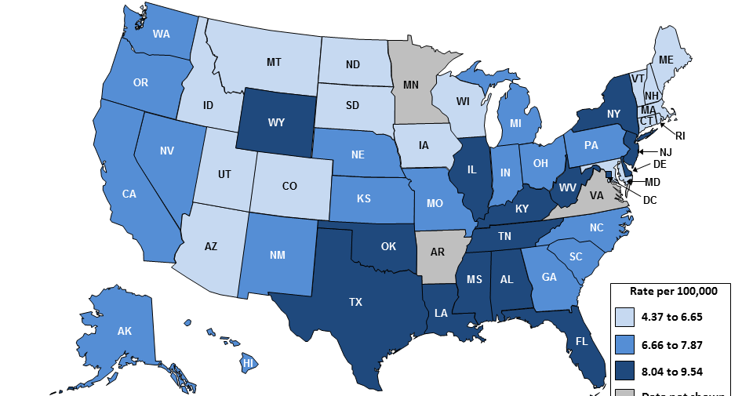
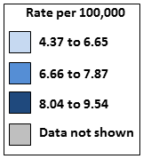
HPV-Associated Cervical Cancer Incidence Rates by State, United States, 2004–2008
HPV-Associated Cervical Cancer Incidence Rates by State, United States, 2006-2010
Nearly 3 million cases of cancer and pre-cancer
$7 billion/ yr
12,000+ Cases and 4,000+ Deaths Every Year *
www.cdc.gov/cancer/npcr
Notes:
This map displays HPV-associated cervical cancer incidence rates by state.
Cervical cancer was once the leading cause of cancer death for women in the United States. Now it is the most preventable of all of the female cancers. The Pap test has helped decrease the number of women in the U.S. with cervical cancer by about 75% in the past 50 years. However even with an excellent cervical cancer screening program in the U.S., there are still over 12,000 cases of cervical cancer each year in this country.
Cervical cancer is the most common HPV-associated cancer among women
528,00 new cases and 266,000 deaths world-wide in 2012
12,000 new cases and 4,000 deaths in the U.S. in 2013
Many people think of gynecological cancers as just affecting older women
But Half of cervical cancers occur in women <50 years
A quarter of cervical cancers occur in women 25-39 years

Slide 11
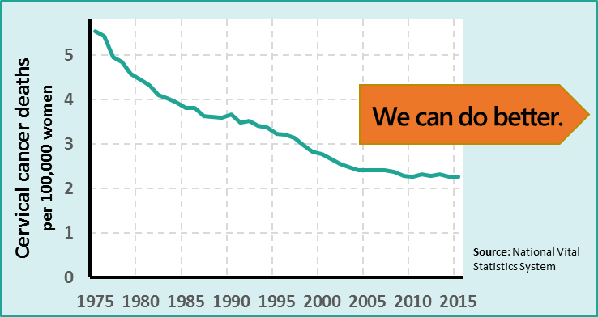
Cervical Cancer
Cervical cancer is the most common HPV-associated cancer among women
528,00 new cases and 266,000 deaths world-wide in 2012
12,000 new cases and 4,000 deaths in the U.S. in 2013
Half of cervical cancers occur in women <50 years
A quarter of cervical cancers occur in women 25-39 years
https://nccd.cdc.gov/uscs/ and http://gco.iarc.fr/today/home
Notes:
Cervical cancer was once the leading cause of cancer death for women in the United States. Now it is the most preventable of all of the female cancers. The Pap test has helped decrease the number of women in the U.S. diagnosed with cervical cancer by about 75% in the past 50 years. However even with an excellent cervical cancer screening program in the U.S., there are still about 12,000 new cases of cervical cancer and 4,000 deaths each year in this country. No women should die of cervical cancer. Worldwide, cervical cancer is the 4th most common cancer among women, and in some countries, it is the most common.
Half of cervical cancer cases in the United States occur in women younger than 50 years, with 1 in 4 of cervical cancer cases among women age 25-39 years, during prime reproductive years. A cervical cancer diagnosis and treatment may be devastating to women and their families for a variety of reasons, including negative effects on their health, welfare, finances, and ability to work. Cervical cancer is treated at minimum with the removal of the cervix but may also include radical hysterectomy, radiation, and/or chemotherapy.

Slide 12
Without vaccination, annual burden of genital HPV-related disease in U.S. females:
4,000 cervical cancer deaths
10,846 new cases of cervical cancer
330,000 new cases of HSIL: CIN2/3
(high grade cervical dysplasia)
1 million new cases of genital warts
1.4 million new cases of LSIL: CIN1
(low grade cervical dysplasia)
Nearly 3 million cases and $7 billion
American Cancer Society. 2008; Schiffman Arch Pathol Lab Med. 2003; Koshiol
Sex Transm Dis. 2004; Insinga, Pharmacoeconomics, 2005
Notes:
Background
The estimated annual incidence of low- and high-grade dysplasia in the United States is 1.4 million, and 330,000 cases, respectively.¹ There are an estimated 1 million new cases of genital warts occurring every year in the United States.² The American Cancer Society estimates that in 2006, 9,710 women in the United States will develop cervical cancer.³
References
1. Schiffman M, Solomon D. Findings to date from the ASCUS-LSIL Triage Study (ALTS). Arch Pathol Lab Med. 2003;127:946–949.
2. Fleischer AB, Parrish CA, Glenn R, et al. Condylomata acuminata (genital warts): Patient demographics and treating physicians. Sex Transm Dis. 2001;28:643–647.
3. American Cancer Society. Cancer Facts and Figures 2006. Atlanta, Ga: American Cancer Society; 2006:4.
Assessing the Annual Economic Burden of Preventing and Treating Anogenital Human Papillomavirus-Related Disease in the US: Analytic Framework and Review of the Literature
Authors: Insinga, Ralph P.¹; Dasbach, Erik J.¹; Elbasha, Elamin H.¹
Source: PharmacoEconomics, Volume 23, Number 11, 2005 , pp. 1107-1122(16)

Slide 13
HPV Vaccine
Evidence-Based HPV Disease Prevention
Notes:
This next section will focus on HPV vaccine recommendations.

Slide 14
HPV Prophylactic Vaccines
Recombinant L1 capsid proteins that form “virus-like” particles (VLP)
Non-infectious and non-oncogenic
Produce higher levels of neutralizing antibody than natural infection
HPV Virus-Like Particle
Notes:
All available prophylactic HPV vaccines are made from virus-like particles. The vaccines do not contain any viral DNA and therefore are non-infectious and cannot cause actual disease or cancer. HPV vaccines produce a better immune response than an HPV infection.

Slide 15
HPV Vaccines Currently Licensed in U.S.
 | Bivalent 2vHPV (Cervarix) | Quadrivalent 4vHPV (Gardasil) | 9-Valent 9vHPV (Gardasil 9)
Manufacturer | GlaxoSmithKline | Merck | Merck
HPV Types Included | 16, 18 | 6, 11, 16, 18 | 6, 11, 16, 18, 31, 33, 45, 52, 58
Contraindications | Hypersensitivity to latex* | Hypersensitivity to yeast | Hypersensitivity to yeast
Dose Schedule | 3 dose series: 0, 1, 6 months | 3 dose series: 0, 2, 6 months | Ages 15-26 3 dose series: 0, 2, 6 months
UPDATED Dose Schedule |  |  | Ages 9-14 2 dose series: 0, 6 months
* May be present in tip of pre-filled syringes
Notes:
There are two brands of HPV vaccine on the market. This slide was developed at the request of healthcare providers who wanted to see a side-by-side comparison of the two vaccines.
No clinical trial data are currently available to demonstrate efficacy for prevention of oropharyngeal or penile cancers. However, because many of these are attributable to HPV16, the HPV vaccine is likely to offer protection against these cancers as well.

Slide 16
HPV Vaccine Comparison
These Genital warts ~66% of ~15% of
HPV Types Cervical Cervical
Cause: Cancers Cancers
RRP
Notes:
Also RRP (Recurrent Respiratory Papillomatosis) caused by 6 & 11

Slide 17
HPV Vaccine Recommendation
CDC recommends routine vaccination
at age 11 or 12 years to prevent HPV cancers, for both boys and girls
The vaccination series can be started at age 9 years
Two doses of vaccine are recommended
The second dose of the vaccine should be administered 6 to 12 months after the first dose.
17
Meites et al. MMWR. 2016.
Notes:
HPV vaccine is routinely recommended for adolescents at age 11 or 12 years. For girls and boys starting the vaccination series before the 15th birthday, the recommended schedule is two doses of HPV vaccine. The second dose should be given six to twelve months after the first dose.

Slide 18
HPV Vaccination is Recommended at Age 11 or 12 Years
Girls & Boys can start HPV vaccination at age 9
Preteens should finish the HPV vaccine series before their 13th birthday
Plus girls 13-26 years old who haven’t started or finished HPV vaccine series
Plus boys 13-21 years old who haven’t started or finished HPV vaccine series
Meites et al. MMWR. 2016.
Notes:
To recap the HPV vaccine recommendations, both girls and boys can start the HPV vaccine series at age nine. Ideally, preteens should finish the series by their 13th birthday. Girls age 13-26 years old and boys age 13-21 years old who haven’t stared or finished HPV vaccine series should also be vaccinated.

Slide 19
Dosing Schedules
Starting the vaccine series before the 15th birthday
Starting the vaccine series on or after the 15th birthday*
Recommended schedule is
2 doses of HPV vaccine
Second dose: 6–12 months after the first dose (0, 6–12 month schedule)
Minimum interval between doses: 5 months
Recommended schedule is
3 doses of HPV vaccine
0, 1–2, 6 month schedule
Minimum interval between dose one and dose three:
5 months
*and immunocompromised persons 9-26 years
Meites et al. MMWR. 2016.
Notes:
The new recommendations for HPV vaccine dosing schedules are:
For persons initiating vaccination before the 15th birthday, the recommended immunization schedule is 2 doses of HPV vaccine. The second dose should be administered 6–12 months after the first dose (for a 0, 6–12 month schedule).
For persons initiating vaccination on or after the 15th birthday, the recommendation for a 3-dose schedule remains. The second dose should be administered 1–2 months after the first dose, and the third dose should be administered 6 months after the first dose (for a 0, 1–2, 6 month schedule).
For persons who initiated vaccination with nine-valent, quadrivalent or bivalent HPV vaccine before their 15th birthday, and received two doses of any HPV vaccine at the recommended dosing schedule (zero, six to twelve months), or three doses of any HPV vaccine at the recommended dosing schedule (zero, one to two, and six months), are considered adequately vaccinated. Persons who initiated vaccination with nine-valent, quadrivalent or bivalent HPV vaccine on or after their 15th birthday, and received three doses of any HPV vaccine at the recommended dosing schedule, are considered adequately vaccinated. Nine-valent HPV vaccine may be used to continue or complete a vaccination series started with quadrivalent or bivalent HPV vaccine.
For persons who have been adequately vaccinated with quadrivalent or bivalent HPV vaccine, there is no ACIP recommendation regarding additional vaccination with nine-valent HPV vaccine.

Slide 20
Updated ACIP Recommendations: Interchangeability
If vaccination providers do not know, or do not have available the HPV vaccine product previously administered, or are in settings transitioning to 9vHPV:
For protection against HPV 16 and 18,
Females: Any HPV vaccine product may be used to continue or complete the series
Males: 4vHPV or 9vHPV may be used to continue or complete the series
20
MMWR 2015;64:300-4
Notes:
Concerning interchangeability, ACIP states that:

Slide 21
ACIP Recommendations: Timing of the Series
If the vaccine schedule is interrupted, the series does not need to be restarted
21
MMWR 2015;64:300-4
Notes:
For administration, there are minor wording changes, but the recommendation is similar to what is was before:

Slide 22
HPV Vaccine Recommendations: Catch Up/Late
Females: Vaccination through age 26
Males: Vaccination through age 21 years; ages 22 through 26 years may be vaccinated.
Vaccination also recommended through age 26
gay, bisexual, and other men who have sex with men (MSM)
transgender people
people with certain immunocompromising conditions (including HIV infection).
22
Meites et al. MMWR. 2016.
Notes:
ACIP also recommends vaccination for females through age 26 years and for males through age 21 years who were not adequately vaccinated previously. Males aged 22 through 26 years may be vaccinated.

Slide 23
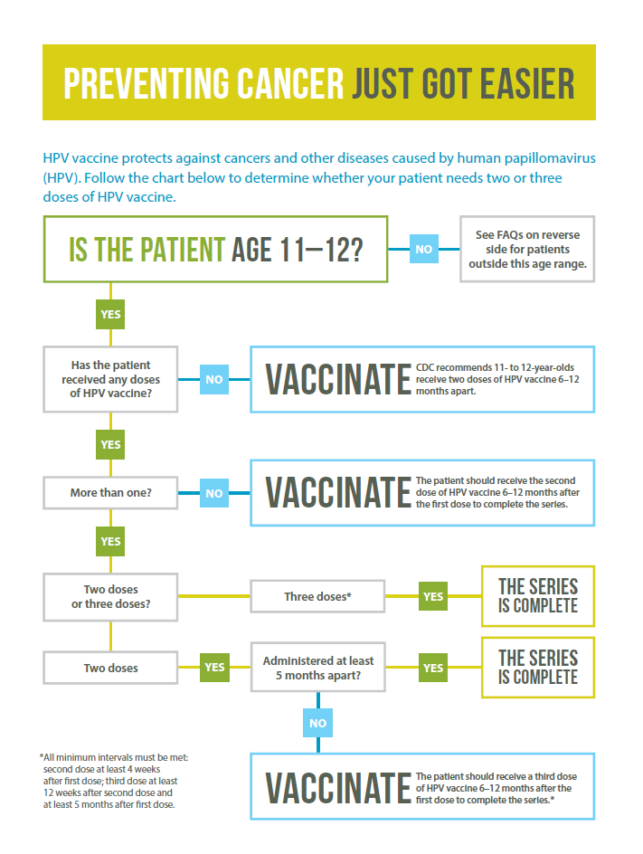
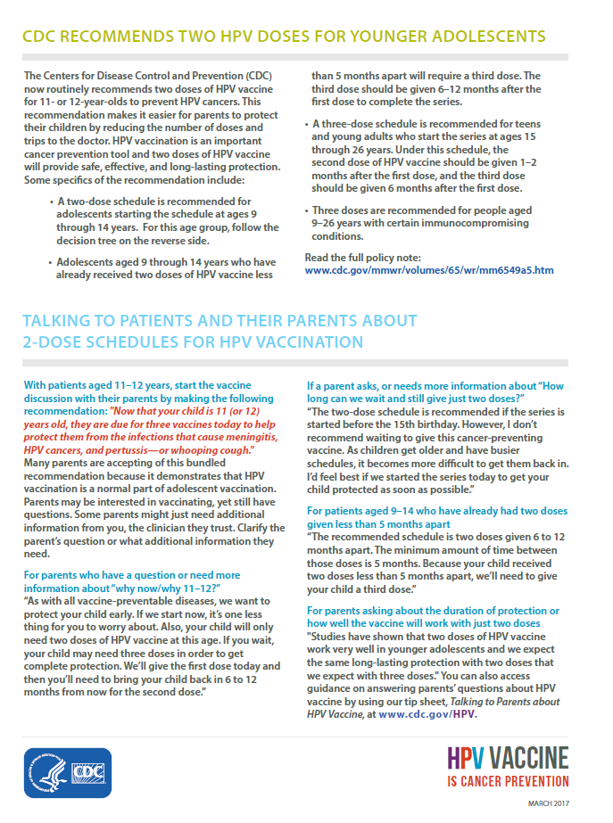
www.cdc.gov/hpv/downloads/hpv-2-dose-decision-tree.pdf
Notes:
This decision tree is an aid to help vaccine providers vaccinate consistent with current recommendations.

Slide 24
HPV Vaccine Safety
Notes:
This next section will focus on HPV vaccine safety.

Slide 25
United States Vaccine Safety System
System | Collaborators | Description
Vaccine Adverse Event Reporting System (VAERS) | CDC and FDA | Frontline spontaneous reporting system to detect potential vaccine safety issues
Vaccine Safety Datalink (VSD) | CDC and 9 Integrated Health Care Systems | Large linked database system used for active surveillance and research ~9.4 million members (~3% of US pop.)
Clinical Immunization Safety Assessment (CISA) Project | CDC and 7 Academic Centers | Expert collaboration that conducts individual clinical vaccine safety assessments and clinical research
Post-Licensure Rapid Immunization Safety Monitoring Program (PRISM) | FDA and 6 partner organizations | Large distributed database system used for active surveillance and research ~170 million individuals
Notes:
All vaccines go though many years of testing and clinical studies before they are licensed for use. CDC and FDA monitor the safety of vaccines after they are licensed. The major systems that monitor and evaluate post-licensure vaccine safety in the United States include: VAERS, VSD, CISA, and PRISM. Safety findings from any of these systems are used to inform health officials, health care providers, and the public.
Monitoring of VAERS Reports
Clinical review of deaths and other pre-specified adverse events
Data mining to identify disproportional reporting
Vaccine Safety Datalink
Near real time monitoring of 10 pre-specified outcomes
Evaluation of spontaneous abortion
Sentinel System
Near real time active surveillance and surveillance of serious, unexpected events
Evaluation of spontaneous abortion
Manufacturer post-marketing commitments
Two, 10-year studies to assess long term safety
Observational study to further characterize the safety profile in 10,000 persons
Pregnancy registry

Slide 26
VAERS: HPV Vaccine Safety Monitoring
Ongoing safety monitoring has shown most reports are non-serious
Among the 7.6% of reports coded as “serious,” most frequently cited possible side effects are headache, nausea, vomiting, and fever
Syncope (fainting) continues to be reported following vaccination among adolescents
Adherence to a 15-minute observation period after vaccination is encouraged
MMWR. 2014;63(RR05);1-30.
26
Notes:
VAERS: Vaccine Adverse Event Reporting System (VAERS)
Anyone who gives or receives a licensed vaccine in the U.S. is encouraged to report any significant health problem that occurs after vaccination. An adverse event can be reported even if it is uncertain or unlikely that the vaccine caused it. Reporting to VAERS helps scientists at CDC and FDA better understand the safety of vaccines.
67 million doses of HPV vaccine distributed in US between June 2006 through March 2014
HPV vaccine safety findings are similar to the safety reviews of MCV4 and Tdap vaccines
Most commonly reported non-serious possible side effects are:
Pain, redness, or swelling in the arm where the shot was given
Fever
Headache or feeling tired
Nausea
Fatigue
Dizziness
Brief fainting spells and related symptoms (such as jerking movements) can happen after any medical procedure, including vaccination. Sitting or lying down for about 15 minutes after a vaccination can help prevent fainting and injuries caused by falls.

Slide 27
VSD Rapid Cycle Analysis (RCA), 4vHPV
RCA allows VSD to detect adverse events following vaccination in near real time
After approx. 600,000 HPV4 doses among females, no significant risk for any of the pre-specified adverse events after vaccination (including GBS, seizures, syncope, appendicitis, stroke, venous thromboembolism, and allergic reactions)
Gee J et al, Vaccine 2011;29:8279-8284.
Notes:
The Vaccine Safety Datalink (VSD) is a collaborative project between CDC's Immunization Safety Office and nine health care organizations.
The VSD uses electronic health data from each participating site. This includes information on vaccines - the kind of vaccine that is given to each patient, date of vaccination, and other vaccinations given on the same day.
Objectives of the VSD
To conduct research on important vaccine safety questions in large populations
To conduct vaccine safety studies that come from questions or concerns in the medical literature or from other vaccine safety systems, like VAERS
To monitor possible adverse events when new vaccines are licensed or when there are new vaccine recommendations
To provide information to committees who make recommendations for the nation
Rapid Cycle Analysis (RCA) allows VSD to detect adverse events following vaccination in near real time so the public can be informed quickly of possible risks.
Using VSD data that are updated each week, the rates of adverse events that occur in people who have received a particular vaccine are compared to the rate of adverse events that occurs in a similar group of people who have not received that vaccine. If the rate of adverse events among vaccinated people is higher than among the comparison group, the vaccine may be associated with an adverse event. There have been a number of studies using RCA addressing the safety of HPV vaccines.
With regards to general safety:
A study was conducted through CDC’s Vaccine Safety Datalink in which near real time monitoring was conducted looking at 8 prespecified conditions, as listed on this slide.
--Reports of these conditions among those who received HPV vaccination and compared to those who were unvaccinated or who received other vaccines
--Data were analyzed after 600,558 doses of HPV4 had been administered to females.
--No statistically significant associations were found

Slide 28
Evaluating and Monitoring 9-valent HPV Vaccine Safety in the United States
Monitoring of VAERS Reports
Clinical review of deaths and other pre-specified adverse events
Data mining to identify disproportional reporting
Vaccine Safety Datalink
Near real time monitoring of 10 pre-specified outcomes
Evaluation of spontaneous abortion
Sentinel System
Near real time active surveillance and surveillance of serious, unexpected events
Evaluation of spontaneous abortion
Manufacturer post-marketing commitments
Two, 10-year studies to assess long term safety
Observational study to further characterize the safety profile in 10,000 persons
Pregnancy registry
Notes:
9-valent HPV vaccine is similar to quadrivalent HPV vaccine in its manufacturing process and content, and the pre-licensure safety data are reassuring. In the United States, the safety of 9-valent HPV vaccine is currently being monitored through review of spontaneous reports, active surveillance, and special epidemiologic studies as listed on this slide.

Slide 29
Over 10 Years of HPV Vaccine Safety Data
HPV vaccine is safe
Reactions after vaccination may include
Injection site reactions: pain, redness, and/or swelling in the arm where the shot was given
Systemic: fever, headaches
HPV vaccines should not be given to anyone who has had a previous allergic reaction to the vaccine or who has an allergy to yeast (Gardasil/Gardasil 9)
Brief fainting spells (syncope) and related symptoms (such as jerking movements) can happen soon after any injection, including HPV vaccine
Patients should be seated (or lay down) during vaccination and remain in that position for 15 minutes
Gee, et al. Hum Vaccin Immunother. 2016.
Notes:
Post licensure HPV vaccine safety data from the United States and other countries over the past 10 years have been robust and reassuring. Based on these data that show the vaccine is safe, what type of side effects do we expect? We know that we can expect HPV vaccination to cause some injection site reactions, possibly fever, and headache. We know that anyone who has any severe allergies, including an allergy to yeast, anyone who has ever had a life-threatening allergic reaction to any component of HPV vaccine or to a previous dose of HPV vaccine, should not be vaccinated. We also know that fainting spells, or syncope, is very common with adolescents when they receive injections. To reduce the risk of syncope patients should be seated while vaccinated and remain in that position or should lay down for 15 minutes.

Slide 30
HPV Vaccination is Safe
HPV vaccine safety studies have been very reassuring: HPV vaccine has a good safety profile
To date, we have not observed any signal that shows that HPV vaccination causes death, neurologic conditions, autoimmune conditions, or venous thromboembolism (VTE).
Clinicians can reassure parents who may have concerns, that HPV vaccination is safe.
https://www.cdc.gov/vaccinesafety/vaccines/hpv/hpv-safety-faqs.html
Notes:
The safety profile for HPV vaccines is well established. The data from HPV vaccine safety studies have been very reassuring. To date, we have not observed any signal (or higher than expected numbers of adverse outcomes) that shows that HPV vaccination causes death, neurologic conditions, autoimmune conditions, or VTE. Despite the availability of reassuring data, concerns still persist and have been highlighted in the media, and especially social media, leaving some parents are hesitant to initiate the vaccination series for their children. It is important that clinician reassure parents who may have concerns, that there have been over 10 years of safety data collected for HPV vaccines, and that HPV vaccination is safe.

Slide 31
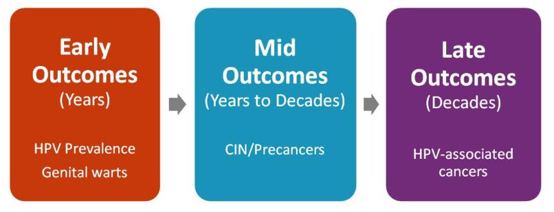
HPV Vaccine Impact
Monitoring Impact of HPV Vaccine Programs on HPV-Associated Outcomes
Notes:
This next section will focus on the impact of HPV vaccine. As you can see in the visual here, impact on early outcomes such as HPV prevalence and genital warts can be demonstrated in just a few years after vaccine introduction. Because of the delay between infection and pre-cancer and then cancer, it will take longer to see impact on disease.

Slide 32
HPV vaccine impact monitoring
Post licensure evaluations are important to evaluate real world effectiveness of vaccines
Population impact against early and mid outcomes have been reported:
HPV prevalence
Australia, Norway, Denmark, Sweden, UK, US
Genital warts
Australia, New Zealand, Denmark, Sweden, Germany, Quebec, US
Cervical lesions
Australia, British Columbia, Denmark, Sweden, US
Notes:
HPV vaccination impact can be monitored through post-licensure evaluations of the various outcomes of HPV infection, including HPV prevalence, genital warts, and precancerous cervical lesions. Reduction in each of these outcomes have been reported in a number of countries.

Slide 33
Prevalence of HPV before & after introduction of HPV vaccination in the United States
64% decline
34% decline
Markowitz L et al. Pediatrics. 2016.
Notes:
The CDC used data collected from the National Health and Nutrition Examination Survey (NHANES) to determine prevalence of HPV infection before and after HPV vaccine introduction. Shown here is the prevalence of any HPV, any non-vaccine type high-risk HPV and vaccine type HPV in the pre-vaccine and vaccine era, in three different age groups. Compared with the prevalence of vaccine type HPV in pre-vaccine era among girls aged 14-19 years, which was 11.5%, vaccine type HPV prevalence dropped to 4.3 percent in the vaccine era 64% after decrease. This is the first age group we’d expect to see an impact of being vaccinated at that time. Prevalence of vaccine-targeted types of HPV also dropped in 20-24 year olds, from 18.5 percent to 12.1 percent, a 34 percent decrease. There was no change in any HPV prevalence or in non-vaccine type high-risk prevalence.

Slide 34
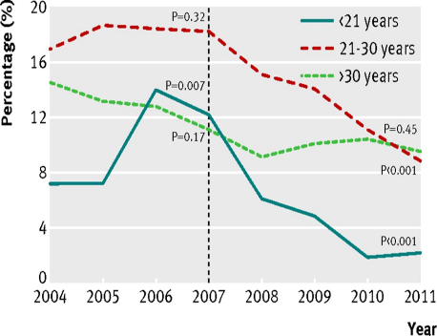
Impact of HPV vaccination in Australia
Proportion of Australian born females and males diagnosed as having genital warts at first visit, by age group, 2004-11
Females
Males
Ali et al. BMJ. 2013
34
Notes:
This slide shows data on genital warts from Australia. The HPV vaccination program in Australia began in 2007 shown by the vertical dashed line. The program initially targeted only female adolescents with catchup through age 26 years; High coverage was reached quickly through school based vaccination. In the left panel, you can see from the teal blue solid line, diagnoses of genital warts decreased dramatically in females under age 21 years soon after start of the vaccine program. A decline was also seen in women 21-30 years. In the right panel, you can see a similar decrease in diagnoses of genital warts in males in these two age groups. Even though males were not being vaccinated. This is probably indicative of a reduction in transmission and herd protection.

Slide 35
Systematic Review and Meta-Analysis: Population-Level Impact of HPV Vaccination
Review of 20 studies in 9 high income countries
In countries with >50% coverage, among 13-19 year olds
HPV 16/18 prevalence decreased at least 68%
Anogenital warts decreased by ~61%
Evidence of herd effects
Some evidence of cross protection against other types
35
Drolet et al. Lancet Infect Dis. 2015
Notes:
These are just two of the studies that have now been published to examine the real-world impact of HPV vaccination. In 2015 a systematic review and meta-analysis of these studies was published which summarized the population-level impact of HPV vaccination. In countries where the HPV vaccine coverage rates were 50% and above among teens, prevalence of infection with HPV 16 and HPV 18 decreased by more than two-thirds and prevalence of anogenital warts decreased by nearly two-thirds. The review found that there is evidence of both herd effects as well as protection with other HPV types not included in the vaccines.

Slide 36
HPV Vaccine Duration of Protection
Studies suggest that vaccine protection is long-lasting
No evidence of waning protection
Available evidence indicates protection for at least 10 years
Multiple studies are in progress to monitor
ACIP. Summary Report. June 22-23, 2016.
Notes:
HPV vaccine has been available in the United States for 10 years. Long-term studies of patients from clinical trials provide data showing there is no evidence that protection against the vaccine types will decrease over time.

Slide 37
HPV Vaccination Is Safe, Effective, and Provides Lasting Protection
HPV Vaccine is SAFE
Benefits far outweigh any potential risks
Safety studies findings for HPV vaccination are reassuring and similar to MenACWY and Tdap vaccine safety reviews
HPV Vaccine WORKS
Population impact against early and mid outcomes have been reported in multiple countries
HPV Vaccine Protection LASTS
Studies suggest that vaccine protection is long-lasting
No evidence of waning protection
Notes:
HPV vaccine is safe, effective and provides lasting protection against the types of HPV that most commonly cause cancer.

Slide 38
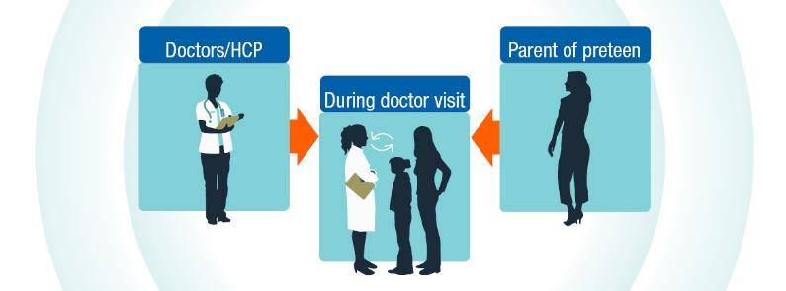
Framing the conversation
Talking about HPV vaccine
Notes:
This next section focuses on strategies to improve HPV vaccine recommendations and conversations with patients and their parents

Slide 39
HPV Vaccine coverage
HPV Vaccine Three-Dose Coverage
United States
Among Girls in High-Income Countries
Notes:
This next section will focus on HPV vaccine coverage.

Slide 40
Adolescent Vaccination Coverage United States, 2006-2015
Revised APD Definition
Reagan-Steiner et al. MMWR 2016.
Notes:
As you can see, the rates of first and third dose of HPV vaccine are not nearly as high as the coverage rates for the other vaccines routinely recommended for 11 and 12 year olds. However, the very important piece of information that this slide provides is that the strong coverage rates for Tdap vaccine demonstrate that not only are most preteens and teens getting to the doctor, but they are also getting at least one of the recommended adolescent vaccines.
Oregon Adolescent Age 13 to 17 Immunization Rate Estimates by County, May 1st 2016
County Tdap Mening HPV (1+) HPV (3) MMR (1+) MMR(2+)
22,553 92.3% 92.3% 60.0% 31.7% 95.7% 89.5%
Table 2. Adolescent Age 13-17 HPV Immunization by Gender in Oregon, May 1st 2016
1+ HPV 3 HPV
Female Male Female Male
66.9% 53.5% 38.6% 25.3%

Slide 41
Incidence of Diseases Covered in Adolescent Vaccine Series
Based on: CDC, 2016; CDC 2015; Viens. MMWR. 2016.
Notes:
References:
Centers for Disease Control and Prevention. "Active Bacterial Core Surveillance Report, Emerging Infections Program Network, Neisseria meningitidis, 2014." http://www. cdc.gov/abcs/reports-findings/survreports/mening14. pdf. Feb2016 File–April 25 (2014): 2016.
Centers for Disease Control and Prevention. "Final pertussis surveillance report." Available in: http://www. cdc. gov/pertussis/downloads/pertuss-survreport-2013. pdf. Accessed Aug 29 (2017).
Viens, Laura J. "Human papillomavirus–associated cancers—United States, 2008–2012." MMWR. Morbidity and Mortality Weekly Report 65 (2016).

Slide 42
Deaths from Diseases Covered in Adolescent Vaccine Series
Based on: CDC, 2016; CDC 2015; American Cancer Society. Cancer Facts & Figures 2016. 2016.
Notes:
References:
Centers for Disease Control and Prevention. "Active Bacterial Core Surveillance Report, Emerging Infections Program Network, Neisseria meningitidis, 2014." http://www.cdc.gov/abcs/reports-findings/survreports/mening14. pdf. Feb2016 File–April 25 (2014): 2016.
Centers for Disease Control and Prevention. "Final pertussis surveillance report." Available in: http://www.cdc.gov/pertussis/downloads/pertuss-survreport-2013. pdf. Accessed Aug 29 (2017).
American Cancer Society. Cancer Facts & Figures 2016. Atlanta: American Cancer Society; 2016. Available at: https://www.cancer.org/content/dam/cancer-org/research/cancer-facts-and-statistics/annual-cancer-facts-and-figures/2016/cancer-facts-and-figures-2016.pdf

Slide 43
Impact of Eliminating Missed Opportunities by Age 13 Years in Girls Born in 2000
Stokley et al. MMWR. 2014.
Notes:
A missed clinical opportunity for HPV vaccination is defined as a healthcare encounter when some, but not all ACIP-recommended vaccines are given. Had HPV vaccine been administered during health care visits when another vaccine was administered, vaccination coverage for at least one 1 dose could have reached 91.3% by age 13 years for adolescent girls born in 2000.
High HPV vaccination coverage with existing infrastructure and health-care utilization is possible in the United States. Taking advantage of every health-care encounter, including acute-care visits, to assess every adolescent’s vaccination status can help minimize missed opportunities. Potential strategies include using vaccination prompts available through electronic health records or checking local and state immunization information systems to assess vaccination needs at every encounter. Series completion also can be promoted through scheduling appointments for second and third doses before patients leave providers’ offices after receipt of their first HPV vaccine doses and with automated reminder-recall systems.

Slide 44
Reasons parents won’t initiate HPV vaccination for children
Stokley et al. MMWR. 2014.
Notes:
Studies consistently show that a strong recommendation from you is the single best predictor of vaccination for any vaccine, including HPV vaccine. In the 2014 NIS-Teen nearly 15% of parents who said that they would not be getting their child vaccinated against HPV in the next 12 months, identified not receiving a recommendation as one of the top reasons not to vaccinate.

Slide 45
Clinicians underestimate the value parents place on HPV vaccine
Adapted from Healy et al. Vaccine. 2014.
Notes:
However, the estimates that clinicians gave for how much value parents place on flu and HPV vaccination are much lower. These clinicians underestimated the value parents place on HPV vaccine. This is evidence of a big disconnect between parents and clinicians.

Slide 46
Clinicians Underestimate the Value Parents Place on HPV Vaccine
“The perceived and real concerns of parents influence how the clinician recommends and administers HPV vaccine.”
Adapted from Healy et al. Vaccine. 2014.
Notes:
Whether a parents concerns are real or just perceived by the clinician, it affects the way HPV vaccine is recommended and administered. This changes the conversation between the clinician and the parents regarding HPV vaccine.

Slide 47
Give an Effective Recommendation to Receive HPV Vaccine at Ages 11 or 12
An effective recommendation from you is the main reason parents decide to vaccinate
Many moms in focus groups stated that they trust their child’s doctor and would get the vaccine for their child as long as they received a recommendation from the doctor
Smith et al. Vaccine. 2016. Unpublished CDC data, 2013.
Notes:
A clinician’s recommendation is the number one reason parents decide to protect their children with vaccination. Regardless of the perceived or real concerns of a parent, an effective recommendation for all adolescent vaccines needs to be given. There is a strong evidence base to support the importance of an effective recommendation.

Slide 48
What is an
EFFECTIVE
recommendation
for HPV vaccination?
Notes:
So that begs the question. What IS an effective recommendation for HPV vaccination?

Slide 49
Same Way Same Day
Notes:
The best and most effective recommendation for HPV vaccination is when HPV vaccine is recommended in the same way and on the same day as the other vaccines recommended for girls and boys at ages 11 and 12 years.

Slide 50
Make an Effective Recommendation
Same way: Effective recommendations group all of the adolescent vaccines Recommend HPV vaccination the same way you recommend Tdap & meningococcal vaccines.
Same day: Recommend HPV vaccine today Recommend HPV vaccination the same day you recommend Tdap & meningococcal vaccines.
Brewer at al. Pediatrics. 2017. Unpublished CDC data, 2013.
Notes:
Successful recommendations group all of the adolescent vaccines
Recommend the HPV vaccine series the same way you recommend the other adolescent vaccines

Slide 51
Your preteen needs three vaccines today to protect against meningitis, HPV cancers, and pertussis.
Brewer at al. Pediatrics. 2017.
Notes:
I want to point out a few things on this slide. The word “today” is especially important because it conveys to the parent that you are recommending that all of these vaccines be given today, not another day.
The order of the vaccine-preventable diseases is also important. We want to sandwich HPV cancers between meningitis, because meningit6is is a disease that parents really want to prevent, and pertussis, because most parents are going to get that vaccine for their child. So meningococcal 1st, HPV cancer 2nd, pertussis 3rd.

Slide 52
Tdap
HPV
MenACWY
Preteen Vaccines
Notes:
We call this the “bundled recommendation” because it bundles all of the vaccines recommended for preteens into one effective and presumptive statement.

Slide 53
Now that Sophia is 11, she is due for three vaccines today. These will help protect her from the infections that can cause meningitis, HPV cancers, and pertussis. We’ll give those shots at the end of the visit.
Notes:
So you could say something like “now that Sophia is 11, she is due for three vaccines. These will help protect her from meningitis, HPV cancers, and pertussis. We’ll give those shots at the end of the visit.”

Slide 54
Now that Sophia is 11, she is due today for three important vaccines. The first is to help prevent an infection that can cause meningitis, which is very rare, but potentially deadly. The second is to prevent a very common infection, HPV, that can cause several kinds of cancer. The third is the “tetanus booster” which also protects against pertussis, so your child doesn’t get whooping cough, but also to protect babies too young to be vaccinated. We’ll give those shots at the end of the visit. Do you have any questions for me?
Notes:
Some of you may feel more comfortable with saying a bit more about each of the vaccines being recommended. Here’s another way to make the bundled recommendation. You can say “Now that your child is 11/12, she is due today for three important vaccines. The first is to help prevent an infection that can cause meningitis, which is very rare, but potentially deadly. The second is to prevent a very common infection—HPV—that can cause several kinds of cancer. The third is the “tetanus booster” which also protects against pertussis, so your child doesn’t get whooping cough, but also to protect babies too young to be vaccinated. We’ll give those shots at the end of the visit. Do you have any questions for me?”

Slide 55
Some Parents Need Reassurance
Many parents simply accept this bundled recommendation
Some parents may be interested in vaccinating, yet still have questions. Interpret a question as they need additional reassurance from YOU, the clinician they trust with their child’s health care
Ask parents about their main concern (be sure you are addressing their real concern)
Unpublished CDC data, 2013.
Notes:
Many parents will accept the bundled recommendation without any questions. Other parents may be interested in vaccinating, yet still have questions for you.
A question from a parents about HPV vaccine does not mean they are refusing or delaying. Many parents with questions about HPV vaccine are looking for additional reassurance from you. Taking the time to listen to parents’ questions helps you save time and give an effective response. Be sure to verify that you are addressing the right concern.

Slide 56
Why does my child need HPV vaccine?
Notes:
Some parents may ask, “Why does my child need HPV vaccine?” This question may also sound like “My daughter doesn’t really need THAT vaccine, does she?” Regardless of how parents ask that question we want them to know that this vaccine is very important for cancer prevention.

Slide 57
HPV vaccination is important because it prevents cancer. That’s why I’m recommending that your child start the HPV vaccine series today.
Notes:
You can respond to them by saying, “HPV vaccination is important because it prevents cancer. That’s why I’m recommending that your child start the HPV vaccine series today.”

Slide 58
What cancers are caused by HPV infection?
Notes:
CDC research with parents has shown that many parents aren’t aware of all of the cancers that can be caused by persistent HPV infection, so some parents may ask you about the cancers that are caused by HPV infection.

Slide 59
Certain HPV types can cause cancer of the cervix, vagina, and vulva in females, cancer of the penis in men, and in both females and males, cancers of the anus and the throat.
We can help prevent infection with the HPV types that cause these cancers by starting the HPV vaccine series today.
Notes:
You can tell parents that HPV infection can cause cervical, vaginal, vulvar, penile, anal, and oropharyngeal cancers, but by starting the HPV vaccines series today, we can prevent infection with the HPV types that most commonly cause those cancers.
You could say “Certain HPV types can cause cancer of the cervix, vagina, and vulva in females, cancer of the penis in men, and in both females and males, cancers of the anus and the throat. We can help prevent infection with the HPV types that cause these cancers by starting the HPV vaccine series today.”

Slide 60
What if my daughter will wait for marriage?

Slide 61
HPV is so common that almost everyone will be infected at some time. When your daughter marries, she could catch HPV from her husband. He might have been infected before he ever met her.
Notes:
You can respond to them by saying, “HPV vaccination is important because it prevents cancer. That’s why I’m recommending that your child start the HPV vaccine series today.”

Slide 62
Is my child really at risk for HPV?
Notes:
It’s hard for parents to see their 11 or 12 year old as being at risk for HPV infection and they make ask about that risk.

Slide 63
HPV is a very common and widespread virus that infects both females and males. We can help protect your child from the cancers and diseases caused by the virus by starting HPV vaccination today.
Notes:
Focus on how common HPV is and how they can protect their child from cancer by saying something like “HPV is a very common and widespread virus that infects both females and males. We can help protect your child from the cancers and diseases caused by the virus by starting HPV vaccination today.”

Slide 64
Why at 11 or 12 years old?
Just like other prevention measures,
need to take action for prevention….
Notes:
Asking why now, or why at 11 or 12, is another way that parents may say that they think their child is too young for “that” kind of behavior, in other words, sexual activity. Help parent understand the importance of vaccination before exposure and that we don’t wait for exposure to occur, or guess when it will occur, before vaccinating.

Slide 65
When should the bike helmet go on?
Before they get on their bike
When they are riding their bike in the street
When they see the car heading directly at them
After the car hits them
Temte JL. Pediatrics 2014.
Notes:
Most people are familiar with, and endorse the use of bicycle helmets. You could also use seatbelts as an example. Ask parents, “When do you want your children to put on their bike helmets? Make the point that we can’t guess when the bike accident risk may occur so we always have our children put on their helmets before getting on their bikes.

Slide 66
When do we put our seat belts on?
Before turning on car
When leaving driveway
After a near accident
Temte JL. Pediatrics 2014.
Notes:
You could also use seatbelts as an example. Ask parents, “When do we put our seat belts on?”

Slide 67
As with all vaccine-preventable diseases, we want to protect your child early. If we start now, it’s one less thing for you to worry about.
Also, your child will only need two shots of HPV vaccine at this age. If you wait until 15, your child will need three shots.
We’ll give the first shot today and then you’ll need to bring your child back in 6 to 12 months from now for the second shot.
Notes:
Or you can just say, “As with all vaccine-preventable diseases, we want to protect your child early. If we start now, it’s one less thing for you to worry about. Also, your child will only need two shots of HPV vaccine at this age. If you wait until 15, your child will need three shots. We’ll give the first shot today and then you’ll need to bring your child back in 6 to 12 months from now for the second shot.”

Slide 68
I’m just worried that my child will perceive this as a green light to have S-E-X.
Notes:
Parents continue to bring concerns about sexual disinhibition following vaccination.

Slide 69
Numerous research studies have shown that getting the HPV vaccine does not make kids more likely to be sexually active or start having sex at a younger age. Starting the HPV vaccine series today will give your child the best protection possible for the future.
Notes:
You can reassure these parents that “Numerous research studies have shown that getting the HPV vaccine does not make kids more likely to be sexually active or start having sex at a younger age. Starting the HPV vaccine series today will give your child the best protection possible for the future.”

Slide 70
“How long can we wait and still give just two doses?”
Notes:
The new two-dose recommendation may cause some parents to think that they can wait another year… or three.

Slide 71
The two-dose schedule is recommended if the series is started before the 15th birthday.
However, I don’t recommend waiting to give this cancer-preventing vaccine. As children get older and have busier schedules, it becomes more difficult to get them back in.
I’d feel best if we started the series today to get your child protected as soon as possible.
Notes:
You can tell these parents, “The two-dose schedule is recommended if the series is started before the 15th birthday. However, I don’t recommend waiting to give this cancer-preventing vaccine. As children get older and have busier schedules, it becomes more difficult to get them back in. I’d feel best if we started the series today to get your child protected as soon as possible.”

Slide 72
I have some concerns about the safety of the vaccine—I keep reading things online that says HPV vaccination isn’t safe.
Do you really know if it’s safe?
Notes:
Naturally, some parents will have questions about HPV vaccine safety.

Slide 73
It sounds like you are generally in support of vaccines, but you have concerns about the safety of HPV. Is that right?
So if you had information that convinced you the HPV vaccine was safe you might consider letting your daughter get it?
I’d like to share with you what I know about the safety of HPV vaccine…
Notes:
You could start with something like, “It sounds like you are generally in support of vaccines, but you have concerns about the safety of HPV. Is that right? So if you had information that convinced you the HPV vaccine was safe you might consider letting your daughter get it? I’d like to share with you what I know about the safety of HPV vaccine…” and then share that specific information with them.

Slide 74
I know there are stories in the media and online about vaccines, and I can see how that could concern you.
However, I want you to know that HPV vaccine has been carefully studied for many years by medical and scientific experts.
Based on all of the data, I believe HPV vaccine is very safe.
Notes:
It is important to acknowledge a parent’s concerns. Try saying something like “I know there are stories in the media and online about vaccines, and I can see how that could concern you. However, I want you to know that HPV vaccine has been carefully studied for many years by medical and scientific experts. Based on all of the data, I believe HPV vaccine is very safe.”

Slide 75
Vaccines, like any medication, can cause side effects. With HPV vaccination this could include pain, swelling, and/or redness where the shot is given, or possibly headache. Sometimes kids faint when they get shots and they could be injured if they fall from fainting. We’ll protect your child by having them stay seated after the shot.
Notes:
If safety concerns are specific to adverse events, explain to parents that “Vaccines, like any medication, can cause side effects. With HPV vaccination this could include pain, swelling, and/or redness where the shot is given, or possibly headache. Sometimes kids faint when they get shots and they could be injured if they fall from fainting. We’ll protect your child by having them stay seated after the shot.”

Slide 76
Could HPV vaccine cause my child to have problems with… ?
Notes:
Sometimes vaccine safety questions can be very specific.

Slide 77
There is no data available to suggest that HPV vaccine will affect future fertility.
However, women who develop cervical cancer could require treatment that would limit their ability to have children.
Starting the HPV vaccine series today could prevent that from happening and protect your daughter’s ability to bear children.
Notes:
If you get a question about fertility concerns you can say “There is no data available to suggest that getting HPV vaccine will have an effect on future fertility. However, women who develop cervical cancer could require treatment that would limit their ability to have children. Starting the HPV vaccine series today could prevent that from happening and protect your daughter’s ability to bear children.”

Slide 78
More than a decade of HPV vaccine safety studies have been very reassuring.
To date, we have not observed any signal that shows that HPV vaccination causes
death/ neurologic conditions/ autoimmune conditions/ venous thromboembolism/ postural orthostatic tachycardia syndrome/ complex regional pain syndrome.
Notes:
If you get questions about other specific safety concerns such as death, neurologic conditions, autoimmune conditions, venous thromboembolism, postural orthostatic tachycardia syndrome, or complex regional pain syndrome you can say, “HPV vaccine safety studies have been very reassuring and date, we have not observed any signal that shows that HPV vaccination causes that health problem.”

Slide 79
How do you know if the vaccine works?
Notes:
Parents may voice concerns about vaccine effectiveness.

Slide 80
Ongoing studies continue to show that HPV vaccination works very well. HPV infections, genital warts, and cervical precancers in young people have all decreased in the years since the vaccine has been available. Starting the vaccine series today will help ensure your child gets the best protection possible.
Notes:
You can let parents know that “Ongoing studies are showing that HPV vaccination works very well and has decreased HPV infection, genital warts, and cervical precancers in young people, in the years since it has been available. Starting the vaccine series today will help ensure your child gets the best protection possible.”

Slide 81
Why do boys need HPV vaccine?
Notes:
As I mentioned previously, many parents are not aware of HPV disease in men and may ask why their male child needs to be vaccination.

Slide 82
HPV infection can cause cancers of the penis, anus, and throat in men.
HPV infection can also cause genital warts.
Getting HPV vaccine today for your son can help prevent the infection that can lead to these diseases.
Notes:
It is important for parents to know that HPV infection causes cancer in men as well. You can say something like “HPV infection can cause cancers of the penis, anus, and throat in men and it can also cause genital warts. Getting HPV vaccine today for your son can help prevent the infection that can lead to these diseases.”

Slide 83
We only want the vaccines needed for school.
Notes:
Occasionally parents will ask you or another person in your medical office if you or they would give HPV vaccine to you/their kids.

Slide 84
All three vaccines are strongly and equally recommended by the CDC.
All three are also recommended by Pediatric, Adolescent, and Family Medicine doctors and groups.
School-entry requirements don’t always reflect the current recommendations for your child’s health.
Notes:
It is important to explain the difference between a recommendation that you are making for the health of your child, versus a legislative decision that is designed to keep kids who may have missed a vaccination from slipping through the cracks. Letting parents know that you, along with CDC and the major medical societies, recommend all of the vaccines equally for their child’s health can help them understand that HPV vaccination is a normal part of adolescent health. You can share with them that “school-entry requirements don’t always reflect the current recommendations for their child’s health.”

Slide 85
Would you get HPV vaccine for your kids?
Notes:
Occasionally parents will ask you or another person in your medical office if you or they would give HPV vaccine to you/their kids.

Slide 86
Yes, I have given HPV vaccine to my child. I believe strongly in the importance of this cancer-preventing vaccine. The American Academy of Pediatrics, the American Academy of Family Physicians, NIH cancer centers, and the CDC, also agree that getting the HPV vaccine is very important for your child.
Notes:
If you have vaccinated you child, you can share that with parents by saying something to the effect of “Yes, I have given HPV vaccine to my child because I believe in the importance of this cancer-preventing vaccine.” You can also tell them that The American Academy of Pediatrics, the American Academy of Family Physicians, NIH cancer centers, and the CDC, also agree that getting the HPV vaccine is very important for your child.”

Slide 87
I heard there is a new HPV vaccine that works better. Should I be getting that for my child who already was vaccinated?
Notes:
Parents with children who have already started or finished the HPV vaccine series with bivalent or quadrivalent HPV vaccine may ask about 9-valent HPV vaccine.

Slide 88
Currently there is no recommendation for additional vaccination for someone who has already completed an HPV vaccine series.
All HPV vaccines protect against the infections that cause most of the cancers.
Notes:
For a parent who ask about having their child receive additional HPV vaccinations, let them know that “Currently there is no recommendation to vaccinate someone with 9-valent HPV vaccine who previously completed the HPV vaccine series. All three HPV vaccines protect against the types that most commonly cause cancer.”

Slide 89
When do we need to come back?
Notes:
A recent study highlighted the need for parents to be told when they need to bring their child in for the remaining doses. Most parents do not know how many shots are in the series or what the intervals are.

Slide 90
Since your child is younger than 15, she will need a second shot in 6 months to a year.
When you check out, please make sure to make an appointment for the second shot and put that appointment on your calendar before you leave today!

Slide 91
Since your child is already 15, she will need a second shot in 1-2 months. The third shot is due 6 months from today.
When you check out, please make sure to make an appointment for about 1-2 months from now and 6 months from now, and put those appointments on your calendar before you leave today!
Notes:
Tell parents, “Your child will need a second dose in 1-2 months. The third dose will be due in 6 months from today. When you check out, please make sure to make an appointment for about 6 weeks from now and 6 months from now, and put those appointments on your calendar before you leave today!”

Slide 92
My child is less than 15 years old, so why does she need a third shot?
Notes:
Some parents may have additional questions about the new dosing schedule.

Slide 93
The recommended schedule is 2 shots given 6 to 12 months apart.
The minimum amount of time between those shots is five months.
Because your child received two shots less than five months apart, we’ll need to give your child a third shot.
Notes:
Try saying, “The recommended schedule is 2 shots given 6 to 12 months apart. The minimum amount of time between those shots is five months. Because your child received two shots less than five months apart, we’ll need to give your child a third shot.”

Slide 94
Will my child be protected with just two shots?
Notes:
This question is more common for parents with older children who have completed the 3-dose series.

Slide 95
Yes! Studies have shown that just two shots given at least six months apart when kids are between 9 and 14 years worked as well or better than three shots given to older adolescents and young adults.
Notes:
Reassure those parents that “Yes! Studies have shown that just two shots given at least six months apart when kids are between 9 and 14 years worked as well or better than three shots given to older adolescents and young adults.”

Slide 96
If a parent doesn’t say yes today…
Ask | Clarify & restate their concerns to make sure you understand
Acknowledge | Emphasize it is the parents’ decision Acknowledge risks & conflicting info sources Applaud them for wanting what is best for their child Be clear that you are concerned for the health of their child, not just public health safety
Advise | Allow time to discuss the pros & cons of the vaccine Be willing to discuss parents’ ideas Offer written resources for parents Tailor your advice using this presentation
Adapted from Henrickson Vax Northwest 2014.
Notes:
A few parents will be hesitant. Here’s a detailed approach to the hesitant parent, based on childhood vaccination work by Vax Northwest.
The steps include: Ask, Acknowledge, & Advise. In short…
-Ask about their concern
-Acknowledge that you know they want to keep their child safe and healthy in every way….and so do you.
-And then advise them on why you recommend getting HPV vaccination now.

Slide 97
If a parent declines today…
Declination is not final. The conversation can be revisited.
End the conversation with at least 1 action you both agree on.
Because waiting to vaccinate is the risky choice, many pediatricians ask the parent to sign a Declination Form.
Notes:
Some parents will not accept your recommendation for their child this year. But that doesn’t mean they won’t ever have their child protected with HPV vaccination. Make sure you leave the door open to revisit the conversation at the following annual visit.

Slide 98
1. Know your coverage rates
How to increase the number of target patients who come in & leave vaccinated
Clinic-level rates are great, but rates for individual clinicians are even better!
Other than AFIX visits, rates can come from
Data from EHR
IIS inputs
Notes:
The first is to know what your rates are. We only improve what we measure. There are a variety of ways to do this. If you are a VFC provider, ask for and attend the next AFIX site visit. If that is not available or won’t be happening soon, have data pulled from your EHR or IIS inputs for all of your 13 year old patients.

Slide 99
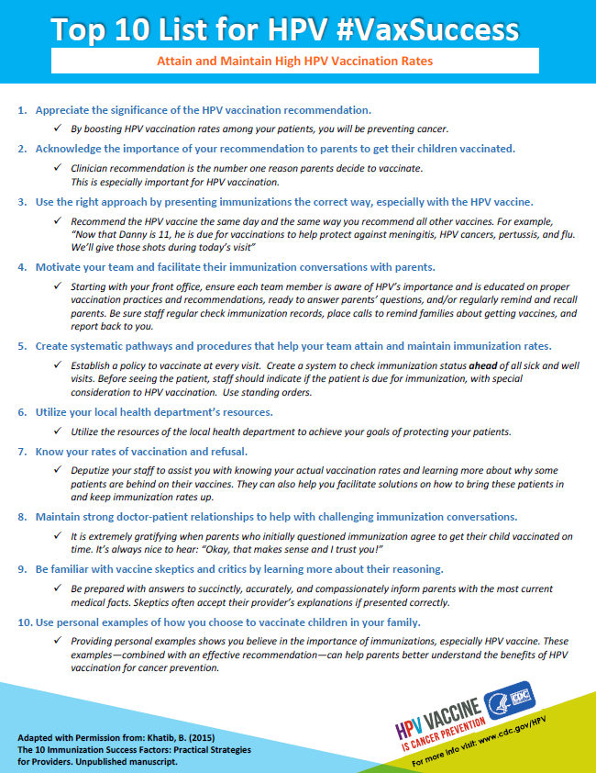
2. Align office/clinic policy with mission
How to increase the number of target patients who come in & leave vaccinated
Immunize at every opportunity
Implement and utilize standing orders
Prompt the person ordering the vaccine in multiple ways
Reminders & Recalls

Slide 100
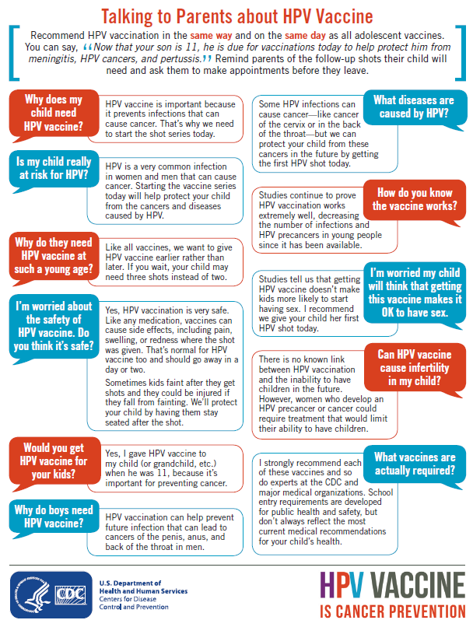
3. Align communication with mission
How to increase the number of target patients who come in & leave vaccinated
Give staff a cancer-prevention mission
All staff need to be saying the same thing
Share talking points
Use the Tip Sheet
Hold an in-service
Notes:
Make sure that all clinic staff, including those answering the phone and making appointments, are communicating the same way about HPV vaccine. Put the focus on cancer prevention and provide talking points for the staff. One way to be sure that staff have the information that they need is to share with them the tip sheet “Addressing Parents’ Top Questions about HPV Vaccine.”

Slide 101
The Opener by the Nurse/MA
Encourage convenient same-day vaccination
“Today, Pat should have 3 vaccines. They’re designed to protect him from the infections that cause meningitis, HPV cancers, and pertussis. Do you have any questions for me?”
If a parents hesitates, the MA/nurse should say
“Our practice is so dedicated to cancer prevention that I’m sure the doctor will want to talk with you about your concerns.”
Notes:
Here is example of how the staff on your team can communicate the importance of HPV vaccination to parents. The MA or nurse can let the parent know that ““Today, Pat should have 3 vaccines. They’re designed to protect him from the cancers caused by HPV and from meningitis, tetanus, diphtheria, & pertussis. Do you have any questions for me?”
If the parent expression hesitation or concern, the staff can respond by saying ““Our practice is so dedicated to cancer prevention that I’m sure the doctor will want to talk with you about your concerns.” This leaves the door open for additional conversation with the clinician.

Slide 102
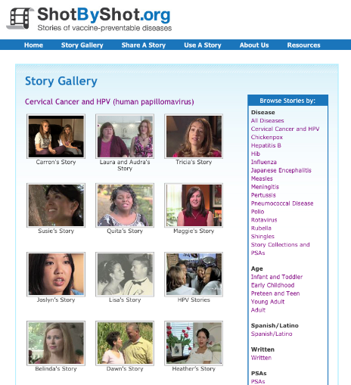
Be sure everyone in the office understands the mission
Human stories often influence people more than statistics To understand the human stories behind HPV, listen to survivors
Shot By Shot
Unprotected People on www.immunize.org
Notes:
If you’re recommending the adolescent vaccines, but no one else in the office is enthusiastic, it may be because they don’t understand the importance of these vaccines.
Be sure everyone in the office understands the mission.
One great way to get everyone on board is by watching the videos on Shot by Shot or Unprotected People on www.immunize.org
The human stories behind pertussis, meningococcal disease, and HPV cancers – often influence people more than statistics.

Slide 103
Standing orders
Empower non-physician personnel to vaccinate patients (after assessing for specific contraindications) without direct physician involvement
Practices should have on file preapproved orders to vaccinate
Templates available for all routine vaccines at www.immunize.org/standing-orders/
To save physicians time, staff have to be aware of the standing orders and be trained to use it
Notes:
Standing orders empower non-physician personnel to vaccinate patients (after assessing for specific contraindications) without direct physician involvement.
Practices should have on file pre-approved orders to vaccinate a class of patients with specified vaccines by a standard protocol.
Templates are available for all routine vaccines at www.immunize.org/standing-orders/
To save physicians time, staff have to be aware of the standing order and trained to use it.

Slide 104
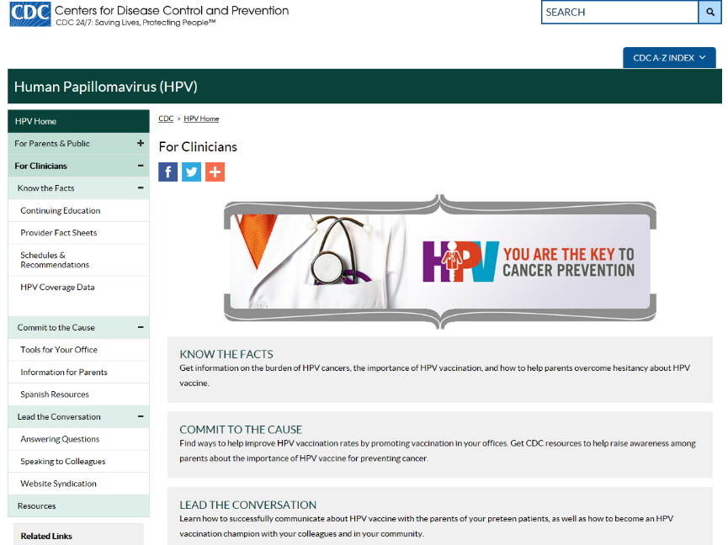
www.cdc.gov/hpv
Notes:
CDC has a variety of resources available to assist clinicians in communicating about HPV vaccine and improving practice to increase immunization rates. Visit CDC.gov slash HPV and click on the section for clinicians.

Slide 105
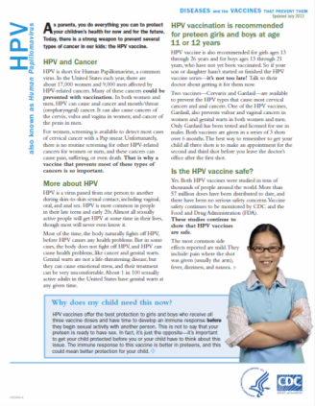
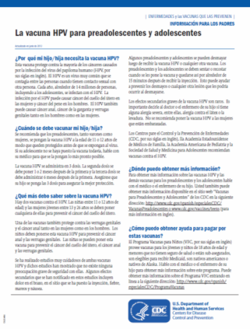
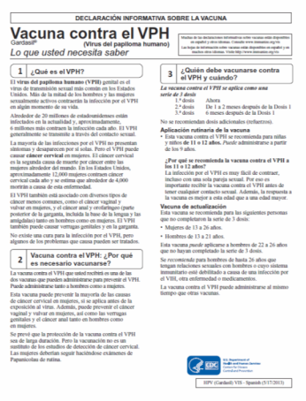
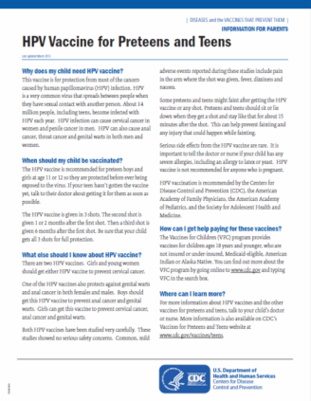
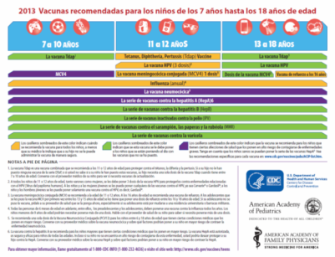
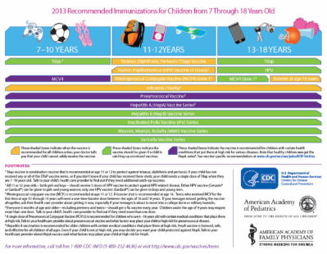
Factsheets for Parents in English & Spanish
Notes:
Fact Sheets for parents

Slide 106
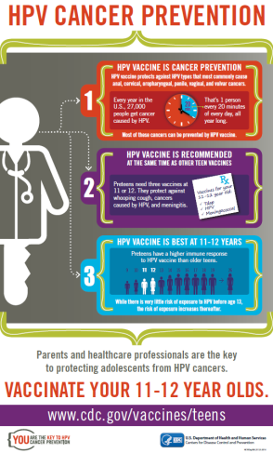
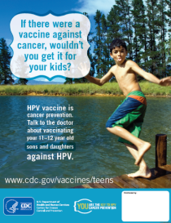
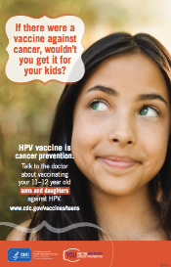
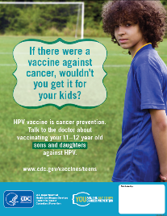
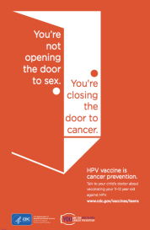
Free posters available for ordering in the following sizes: 8.5x11, 11x17, 18x24
cdc.gov/vaccines/who/teens/infographic/hpv-cancer-prevention.html
Notes:
Posters

Slide 107
HPV VACCINE IS CANCER PREVENTION
And YOU are the key!
#WeCanStopHPV

Slide 108
References
Advisory Committee on Immunization Practices. Summary Report. June 22-23, 2016. Available at https://www.cdc.gov/vaccines/acip/meetings/downloads/slides-2016-06/june-22-23-2016-acip.pdf
Ali H, et al. Genital warts in young Australians five years into national human papillomavirus vaccination programme: national surveillance data BMJ 2013; 346 :f2032.
Baldur-Felskov et al. Trends in the incidence of cervical cancer and severe precancerous lesions in Denmark, 1997-2012. Cancer Causes Control 2015 Aug;26(8):1105-16.
Benard VB, Castle PE, Jenison SA, et al. Population-Based Incidence Rates of Cervical Intraepithelial Neoplasia in the Human Papillomavirus Vaccine Era. JAMA Oncol. Published online September 29, 2016. doi:10.1001/jamaoncol.2016.3609
Brewer NT, et al. Announcements versus conversations to improve HPV vaccination coverage: A randomized trial. Pediatrics. 2017 139(1).
Drolet et al. Population-level impact and herd effects following human papillomavirus vaccination programmes: a systematic review and meta-analysis. Lancet Infect Dis. 2015 May;15(5):565-80.
Gee, et al. Quadrivalent HPV vaccine safety review and safety monitoring plans for nine-valent HPV vaccine in the United States. Hum Vaccin Immunother. 2016 Jun; 12(6): 1406–1417.
Hariri S, et al. Population-based trends in high-grade cervical lesions in the early human papillomavirus vaccine era in the United States. Cancer, 121: 2775–2781.
Healy CM, et al. Parent and provider perspectives on immunization: are providers overestimating parental concerns? Vaccine. 2014; 32(5): 579-584.
Henrikson NB, et al. A public-private partnership addressing vaccine hesitancy in Washington State. 2014. Available at: http://vaxnorthwest.org/approach
Institute of Medicine. Adverse Effects of Vaccines: Evidence and Causality. The National Academies Press, 2012.
Koshiol JE, et al. Rate and predictors of new genital warts claims and genital warts-related healthcare utilization among privately insured patients in the United States. Sex Transm Dis. 2004;31:748–752.
Machalek et al. Human Papillomavirus Prevalence in Unvaccinated Heterosexual Men After a National Female Vaccination Program. J Infect Dis (2017) 215 (2): 202-208. Published: 03 November 2016. DOI: 10.1093/infdis/jiw530
Markowitz LE, et al. Prevalence of HPV After Introduction of the Vaccination Program in the United States. Pediatrics. 2016;137(2).
Meites E, Kempe A, Markowitz LE. Use of a 2-Dose Schedule for Human Papillomavirus Vaccination — Updated Recommendations of the Advisory Committee on Immunization Practices. MMWR. 2016;65(49);1405-8.
Petrosky et al. Use of 9-Valent Human Papillomavirus (HPV) Vaccine: Updated HPV Vaccination Recommendations of the Advisory Committee on Immunization Practices. MMWR. 2015 64(11);300-304
Pollock et al. Reduction of low- and high-grade cervical abnormalities associated with high uptake of the HPV bivalent vaccine in Scotland. Br J Cancer 2014 111, 1824–1830.
Reagan-Steiner S, et al. National, Regional, State, and Selected Local Area Vaccination Coverage Among Adolescents Aged 13–17 Years — United States, 2015. MMWR Morb Mortal Wkly Rep. 2016;65:850–858.
Satterwhite et al. Sexually transmitted infections among US women and men: prevalence and incidence estimates, 2008. Sex Transm Dis. 2013 Mar;40(3):187-93.
Schiffman M. Castle PE. Arch Pathol Lab Med. Human papillomavirus: epidemiology and public health. 2003 Aug;127(8):930-4.
Smith PJ, et al. HPV vaccination coverage of teen girls: the influence of health care providers. Vaccine. 2016 Mar 18;34(13):1604-10.
Stokley S,, et al. Human papillomavirus vaccination coverage among adolescents, 2007-2013, and postlicensure vaccine safety monitoring, 2006-2014--United States. MMWR Morb Mortal Wkly Rep. 2014 Jul 25;63(29):620-4.
Temte JL. Comment: Timing of HPV Vaccine. Available at http://pediatrics.aappublications.org/content/early/2014/08/12/peds.2014-0442.comments#-timing-of-hpv-vaccine-
Viens LJ, et al. Human papillomavirus–associated cancers—United States, 2008–2012. MMWR. 2016;65:661–6.

