Slide 1

HPV Prevention and the Dental Community
Susan Babcock, PHN and Kelly Barrows, VC
Notes:
(Kelly slides 1-10) Hello everyone, I am Kelly Barrows, Childhood Vaccine compliance coordinator with Snohomish Health District and this is Susan Babcock Public Health Nurse with the Vaccine Preventable Disease Program at Snohomish Health District and Paul Benedict HPV Cancer survivor and advocate. We so appreciate the invitation to come speak with you about HPV infection and related Oral Pharyngeal cancers and how the dental community can assist public health to reduce those affected by HPV in the future. The three of us are very passionate about the subject as HPV has impacted all three of us in different ways.
Collaborating with dental professionals to educate on HPV has been an ongoing initiative of the WA state HPV Task Force. Last May, I had the good fortune to attend the National Immunization Conference in Atlanta. There I attended a presentation by David Bradberry of the Georgia Dental association on this very subject. I approached Dr Bradberry via email when I got back home and was given permission to borrow some of his slide content.
We do ask that in the interest of time that you save questions for the end of our presentation. We have provided packets with many of the tools that we will discuss and ask that you review them when we have completed. Thank you!!

Slide 2
Learning Objectives
Educate dental providers on HPV related oral cancers
Demonstrate the link between HPV prevention and the dental community
Educate on HPV vaccine recommendations and safety
Provide resources to assist dental professionals with educating their patients

Slide 3
Oropharyngeal Cancer (OPC) Facts
Everyone is at risk for OPC.
Unlike oral cavity cancers, smoking and drinking are not common risk factors.
8 out of 10 people will contract Human Papillomavirus (HPV) at some point.
Notes:
OPC, also known as squamous cell carcinoma of the pharynx, including the tonsils and base of tongue, is on the rise and is a difficult cancer to detect before it spreads. Unlike pap tests that detect cervical HPV virus infection and associated cancers there is currently no accurate testing mechanisms for Oral HPV infection. As the slide says everyone is at risk and 80% of people will contract a strain of Human Papillomavirus in their lifetime. But unlike other oral cancers smoking and drinking are not common risk factors.

Slide 4
More OPC Facts
Incidence of OPC has overtaken that of cervical cancer.
HPV causes 70% of OPC in the US.
60% of OPC is HPV type 16 which is covered by the HPV vaccine.
Middle aged men are at greater risk for contracting HPV related OPC.
Notes:
OPC rates are now higher than cervical cancer in this country and 70% of those cases are caused by HPV with 60% being HPV type 16 which is covered by the vaccine. Middle aged men are at the greatest for developing HPV related OPC.
While OPC is highly treatable if detected early, the treatments and side effects are very severe. 5 year relative survival rate for those with localized disease at diagnosis is 83%, compared with only 36% in patients with metastasized cancer.

Slide 5
What does the ADA say?
“…if the rise in incidence (OPC) continues at its present pace, the incidence of oropharyngeal cancers among males will overtake that of cervical cancers by the year 2020…”
https://www.ada.org/en/about-the-ada/ada-positions-policies-and-statements/statement-on-human-papillomavirus-and-squamous-cel
Notes:
This Predication was made by the American Dental Association in early 2015 before the CDC had statistics on HPV related cancer cases for that year.

Slide 6

Number of HPV-Associated and HPV-Attributable Cancer Cases per Year, U.S., 2011–2015
Cancer Site | Number of HPV-associated cancers | Percentage probably caused by any HPV type | Number probably caused by any HPV type
 |  |  | Female | Male | Both Sexes
Cervix | 11,866 | 91% | 10,751 | 0 | 10,751
Vagina | 846 | 75% | 635 | 0 | 635
Vulva | 3,934 | 69% | 2,707 | 0 | 2,707
Penis | 1,269 | 63% | 0 | 803 | 803
Anus | 6,530 | 91% | 4,008 | 1>949 | 5,957
Oropharynx | 18,226 | 70% | 2,160 | 10,725 | 12,885
Total | 42,671 | 79% | 20,260 | 13,447 | 33,737
Sources: https://www.cdc.gov/cancer/hpv/statistics and Saraiya M et al. J Natl Cancer Inst. 2015;107:djv086

Slide 7
JADA January 2018
Encourages dentists to educate themselves and their patients about the relationship between HPV and oropharyngeal cancer, especially the growing prevalence of these cancers in younger non-smokers and non-drinkers.
“The ADA will continue to provide guidance to the dental profession about HPV-associated oropharyngeal cancer, promote early oropharyngeal cancer detection, and expand public awareness of the oncogenic potential of some HPV infections.”
Notes:
In January 2018 the Journal of American Dental association published an article encouraging dentist to educate themselves and their patients about the relationships between HPV and Oral pharyngeal cancer. They will continue to provide guidance to dental professionals about HPV associated OPC in order to promote early cancer detection and increase public awareness. The article also states the more that dental health professionals know about HPV prevention activities such as the HPV vaccine the better suited they are to be a line of protection against HPV and cancer.

Slide 8
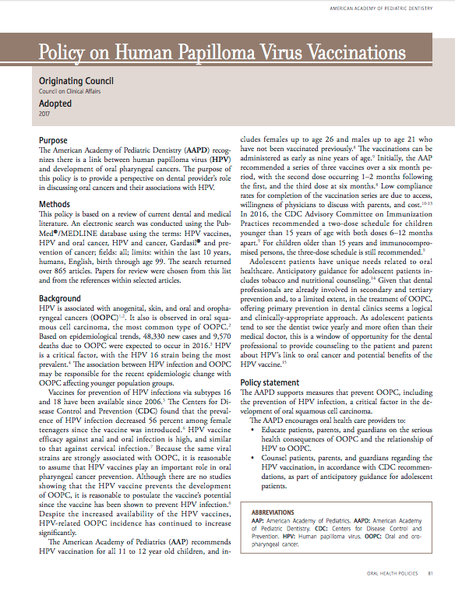
American Academy of Pediatric Dentistry (AAPD)
AAPD is the authority on children’s oral health and dental care
This statement originated in Council on Clinical Affairs
Adopted in 2017
OOPC = oral and oropharyngeal cancers
Notes:
In 2017 The American Academy of Pediatric dentistry adopted this policy on Human papilloma virus vaccinations which encourages dental professionals to add HPV education to the oral healthcare education already provided in the dental office on topics such as tobacco use, nutrition and oral hygiene.

Slide 9
The AAPD encourages oral health care providers to:
Educate patients, parents, and guardians on the serious health consequences of OOPC and the relationship of HPV to OOPC.
Counsel patients, parents, and guardians regarding the HPV vaccination, in accordance with CDC recommendations, as part of anticipatory guidance for adolescent patients.
Routinely examine patients for oral signs of and changes consistent with OOPC.
Follow current literature and consider incorporating other approaches for HPV prevention in their practices so as to minimize the risk of disease transmission.
Notes:
The AAPD policy also encourages the dental community to Educate on the serious health consequences of oral and oralpharyngeal cancers and the relationship to HPV, to Counsel patients, parents and guardians about the HPV Vaccination as part of their anticipatory guidance for adolescent patients, routinely examine patients looking for signs and changes that could be cancer and to study current literature regarding HPV prevention and to share that knowledge with their patients to minimize the risk of disease transmission.

Slide 10
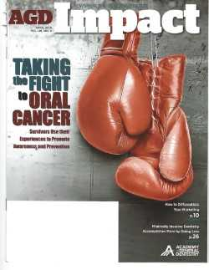
AGD Impact April 2017
The monthly news- magazine for the Academy of General Dentistry (AGD)
Notes:
The cover of the Academy of General Dentistry article, “Taking the Fight to Oral Cancer” perfectly represents the current battle of HPV cancer patients, survivors and healthcare professionals of all types to overcome HPV cancers.

Slide 11
National Oral Health Conference
The Premier Meeting for Dental Public Health
Presented by:
  American Association of Public Health Dentistry (AAPHD)
  Association of State and Territorial Dental Directors (ASTDD)
  April 2018 NOHC included a session, “Promoting the HPV Vaccine: An Opportunity for Medical-Dental Collaboration”.
Notes:
This April 2018 National Oral Health Conference included a session entitled Promoting the HPV Vaccine: An opportunity for Medical-Dental Collaboration which is another example of the current ongoing activities related to OPC and the dental community. We at public health are so appreciative of the spotlight being shown on HPV infection, it’s associated cancers and it’s prevention.

Slide 12
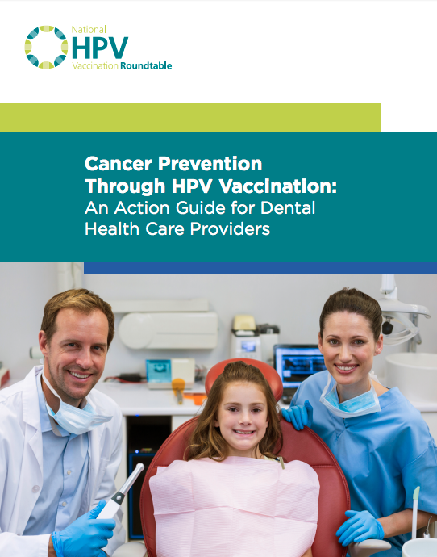
ADA Collaboration with the HPV Roundtable
Developed with representation from:
American Academy of Family Physicians
American Association of Public Health Dentistry
American Cancer Society
Head and Neck Cancer Alliance
Notes:
(Susan slides 11-27) HPV education and awareness in the dental care setting is becoming an important topic and gaining momentum. Great partnerships with many types of medical entities have developed since the inception of the National HPV Roundtable, increasing the awareness in our community. The Action Guide for Dental Health Care providers is a byproduct of this collaboration. In attendance at the Washington HPV summit last fall were health care professionals; medical and dental; from all arenas with one common goal, to reduce the incident of HPV related cancers. There is a copy of the action guide pictured here in your packets.

Slide 13
The Action Guide message:
Oral health professionals play a critical role in combating growing rates of HPV-positive oropharyngeal cancers...
Oral health professionals should strongly and clearly recommend HPV vaccination to all age-eligible patients.
Notes:
The Key messages of the action guide are: (READ SLIDE!)

Slide 14
Actions At-A-Glance
Know your unique role Action 1
Practice cancer prevention Action 2
Refer patients for vaccinations Action 3
Collaborate Action 4
Engage your team Action 5
  Create a pro-vaccine environment
  Patient Education Tools
Notes:
(READ SLIDE!): “The Actions At a Glance are Action 1…..(READ SLIDE! Action #’s First!)

Slide 15
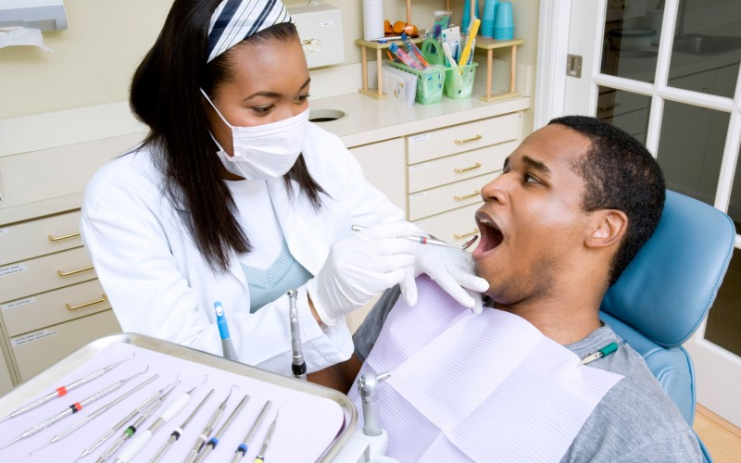
Why does Public Health want to partner with the dental community?
84.8 % of US
children, ages 2-17, had an annual preventative dental exam in 2016.
https://www.cdc.gov/nchs/data/hus/hus16.pdf#060
Notes:
(READ SLIDE!) *In an Immunization Action Coalition Adolescent Update webinar from September 2018, we learned that only 1/3 of teens see a medical provider annually and only half these medical related visits are wellness exams.

Slide 16
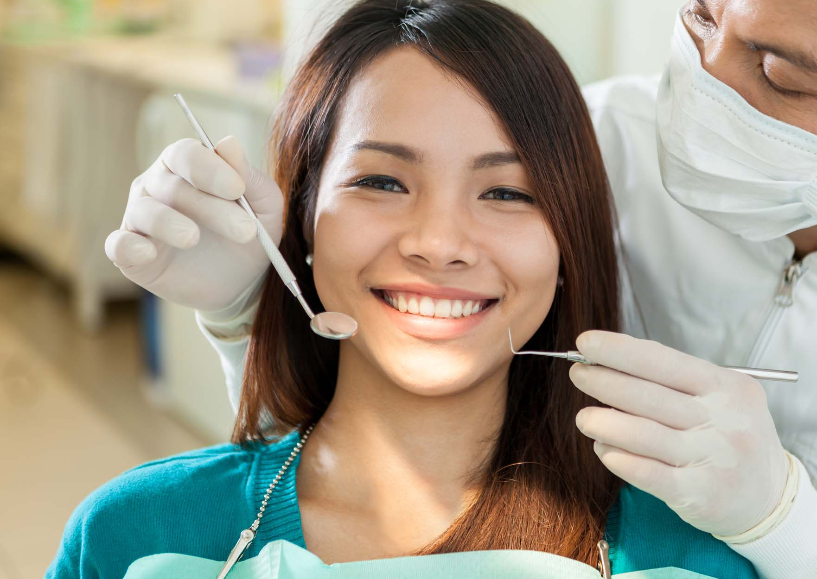
DENTAL PROFESSIONALS ARE KEY
TO HPV CANCER PREVENTION!
Notes:
Along side of other professionals in the medical community, dental professionals are key to HPV cancer prevention.

Slide 17
More from the ADA
“Given this emerging evidence, it has been suggested that use of prophylactic HPV vaccines directed against HPV-16 and HPV-18 infection may reduce OSCC (oral squamous cell cancer) incidence.”
https://www.ada.org/en/about-the-ada/ada-positions-policies-and-statements/statement-on-human-papillomavirus-and-squamous-cel
Notes:
Here is another statement made by the ADA: (READ SLIDE!) *Recommend the HPV vaccine to all unvaccinated boys and girls over 9 years of age and unvaccinated adults through age 26.

Slide 18
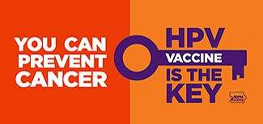
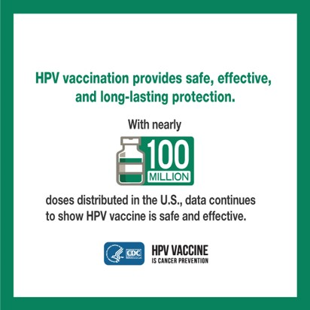
HPV Vaccine
2006 licensed females
quadrivalent/bivalent
through 11-26
2009 licensure includes males through 21; MSM through 26; quadrivalent only
2014 licensed nine-valent; both sexes
FDA approval of vaccine administration to age 45 10/18
Notes:
Here is some information about the HPV vaccine: It was licensed in 2006 for females when both the quadrivalent vaccine, which covered 4 HPV strains and the bivalent vaccine, which covered 2 HPV strains were available for females 11-26 yrs. In 2009 the quadrivalent vaccine was licensed for males through age 26 yrs. In 2014 the HPV 9 valent vaccine, covering 9 HPV strains was licensed for both males and females. Most recently, this last fall, the FDA approved HPV vaccine administration up to age 45 yrs.

Slide 19
Dosing Schedules
Starting the vaccine series before the 15th birthday
  Recommended schedule is
  2 doses of HPV vaccine
  Second dose should be administered 6–12 months after the first dose (0, 6–12 month schedule)
  Minimum interval between dose 1 and dose 2 in a 2-dose schedule is 5 months
Starting the vaccine series on or after the 15th birthday*
Recommended schedule is
3 doses of HPV vaccine
  Second dose should be administered 1–2 months after the first dose, and the third dose should be administered 6 months after the first dose (0, 1–2, 6 month schedule)
  Minimum interval between dose one and dose three in a 3-dose schedule is 5 months
*And immunocompromised persons 9-26 years
Meites et al. MMWR. 2016.
Notes:
The recommendations for HPV vaccine dosing schedules are:
For persons initiating vaccination before the 15th birthday, the recommended immunization schedule is 2 doses of HPV vaccine. The second dose should be administered 6–12 months after the first dose (for a 0, 6–12 month schedule).
For persons initiating vaccination on or after the 15th birthday, the recommendation for a 3-dose schedule remains. The second dose should be administered 1–2 months after the first dose, and the third dose should be administered 6 months after the first dose (for a 0, 1–2, 6 month schedule).
For persons who initiated vaccination with nine-valent, quadrivalent or bivalent HPV vaccine before their 15th birthday, and received two doses of any HPV vaccine at the recommended dosing schedule (zero, six to twelve months), or three doses of any HPV vaccine at the recommended dosing schedule (zero, one to two, and six months), are considered adequately vaccinated. Persons who initiated vaccination with nine-valent, quadrivalent or bivalent HPV vaccine on or after their 15th birthday, and received three doses of any HPV vaccine at the recommended dosing schedule, are considered adequately vaccinated. Nine-valent HPV vaccine may be used to continue or complete a vaccination series started with quadrivalent or bivalent HPV vaccine.
For persons who have been adequately vaccinated with quadrivalent or bivalent HPV vaccine, there is no ACIP recommendation regarding additional vaccination with nine-valent HPV vaccine.

Slide 20


HPV Vaccination is Recommended at Age 11 or 12 Years
Girls & Boys can start HPV vaccination at age 9
Preteens should finish the HPV vaccine series before their 13th birthday
Plus girls 13-26 years old who haven’t started or finished HPV vaccine series
Plus boys 13-21 years old who haven’t started or finished HPV vaccine series
Notes:
To recap the HPV vaccine recommendations, both girls and boys can start the HPV vaccine series at age nine. Ideally, preteens should finish the series by their 13th birthday. Girls age 13-26 years old and boys age 13-21 years old who haven’t stared or finished HPV vaccine series should also be vaccinated. Most recently, this last fall, the FDA approved HPV vaccine administration up to age 45 yrs. Currently the Vaccines for Children program only provides the 9 valent HPV vaccine for children up until their 19th birthday. HPV vaccine can be given at 9 years of age, but is recommended to be given at 11 – 12 years of age along with the Tdap and Meningococcal vaccines. Many medical providers and pharmacies provide the vaccine to adults from 19 through 26 years of age.

Slide 21
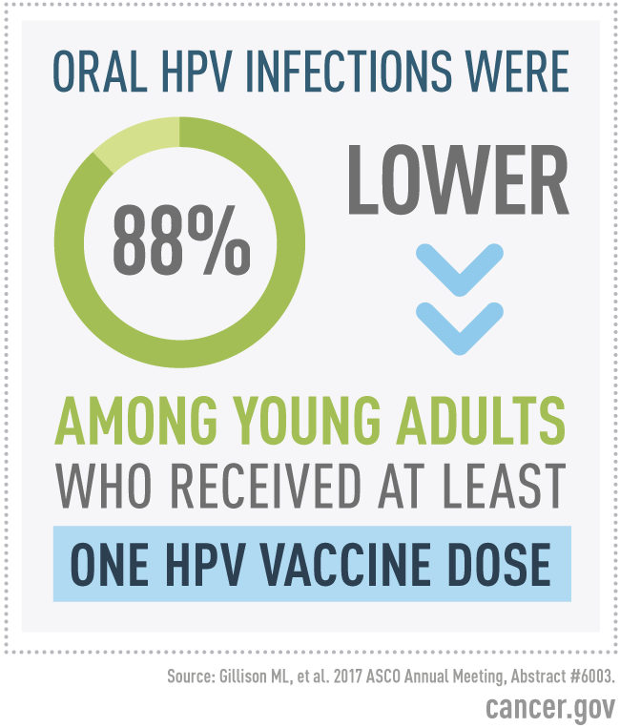
Is the Vaccine Effective???
Notes:
The June 5, 2017 article by the National Cancer Institute says that a study of more than 2,600 young adults in the United States found that the prevalence of oral infection with four HPV types, including two high-risk, or cancer-causing, types, was 88% lower in those who reported receiving at least one dose of an HPV vaccine than in those who said they were not vaccinated.

Slide 22
United States Vaccine Safety System
System | Collaborators | Description
Vaccine Adverse Event Reporting System (VAERS) | CDC and FDA | Frontline spontaneous reporting system to detect potential vaccine safety issues
Vaccine Safety Datalink (VSD) | CDC and 9 Integrated Health Care Systems | Large linked database system used for active surveillance and research ~9.4 million members (~3% of US pop.)
Clinical Immunization Safety Assessment (CISA) Project | CDC and 7 Academic Centers | Expert collaboration that conducts individual clinical vaccine safety assessments and clinical research
Post-Licensure Rapid Immunization Safety Monitoring Program (PRISM) | FDA and 6 partner organizations | Large distributed database system used for active surveillance and research ~170 million individuals (~53 of US pop)
Notes:
All vaccines go through many years of testing and clinical studies before they are licensed for use. CDC and FDA monitor the safety of vaccines after they are licensed. The major systems that monitor and evaluate post-licensure vaccine safety in the United States include: VAERS, VSD, CISA, and PRISM. Safety finding from any of these systems are used to inform health officials, health care providers and the public.

Slide 23
Notes:
HPV vaccine safety is still a hot topic, especially on social media. The Center for Disease Control developed this fact sheet on the safety of the vaccine including a timeline of testing.
Common Side Effects of HPV Vaccine:
Pain, redness, or swelling in the arm where the shot was given; Fever; Headache or feeling tired; Nausea; Muscle or joint pain. Fainting spells after any vaccination are not uncommon in adolescents.

Slide 24
Myth Busters
No significant increased risk for Guillain-Barre syndrome
No causal association between HPV vaccine and complex regional pain syndrome, postural orthostatic tachycardia syndrome, premature ovarian insufficiency or ovarian failure
Syncope was established as a common anxiety or stress-related reaction to the injection
Inadvertent administration of HPV vaccine during pregnancy has no known adverse outcomes in either mother or infant
https://www.who.int/vaccine_safety/committee/topics/hpv/en/
Notes:
Since licensure, 270 Million doses of HPV vaccine have been distributed. The World Health Organization’s Global Advisory Committee on Vaccine Safety published the safety update of HPV Vaccine based on 7 different studies starting in 2007, with the latest one completed on July 14, 2017 and they all state the following: (READ SLIDE!) *The Committee continues to express concern that the ongoing unsubstantiated allegations have a demonstrable negative impact on vaccine coverage in a growing number of countries, and that this will result in real harm.

Slide 25
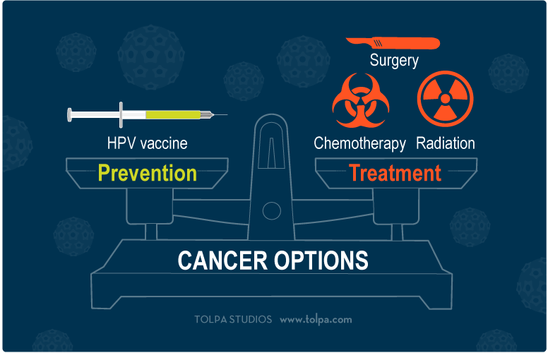
A binary choice: cancer prevention with the vaccine, or someday possible treatment without it
Notes:
Know your options, the choice between prevention and Treatment-Special thanks to Stewart Lyman Ph.D.; HPV vaccine advocate and cancer survivor; for his HPV Cancer Resources website for some of our slide content.

Slide 26
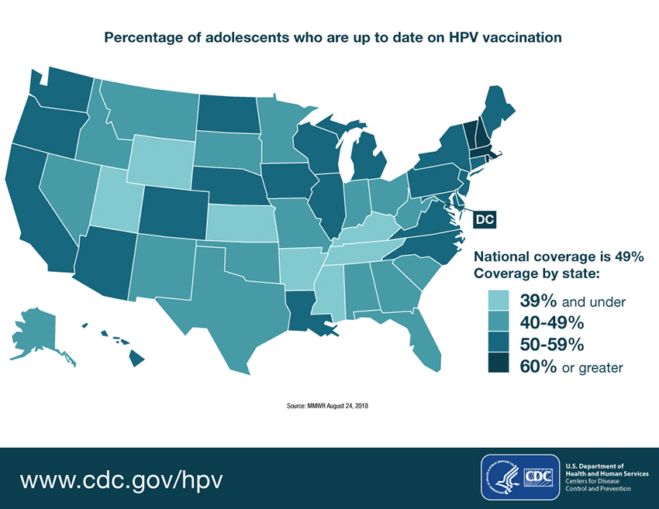
National HPV Vaccination Coverage Rate
Notes:
The National Coverage up to date rate for HPV vaccine for adolescents as of a CDC National Immunization Survey report dated August 2018. The Office of Disease Prevention and Health promotion’s Healthy People 2020 Goal for 13-15 year old girls and boys is 80 %,. We have a long way to go and a short time to get there.

Slide 27
Parents of unvaccinated girls – top reasons for not starting HPV vaccine series
Notes:
Studies consistently show that a strong recommendation from there provider is the single best predictor of vaccination for any vaccine, including HPV vaccine. In the 2013 NIS-Teen nearly 15% of parents who said that they would not be getting their child vaccinated against HPV in the next 12 months, identified not receiving a recommendation as one of the top reasons not to vaccinate. Since teens are more likely to see their dental provider, a recommendation at a routine exam may positively influence their decision to vaccinate.

Slide 28
Tips for talking with Patients about HPV and Oral Cancer
Place brochures or other educational literature on HPV-related oral cancers available in your reception area.
Establish a practice philosophy on how to approach HPV and oral cancer.
Add sections to your patient questionnaire about HPV vaccine history and whether the patient would like to discuss oral cancer concerns in private.
Notes:
Here are some suggestions for talking with your patients about HPV and oral cancer:
Having brochures and other educational literature on HPV-related oral cancers available in reception and waiting areas
Establishing a practice philosophy on how to approach HPV and oral cancer
Incorporate sections into your patient health Hx form about HPV vaccine history and whether the patient would like to discuss oral cancer concerns in private

Slide 29
Talking Points
Notes:
There are great resources available, like the ones shown here, to help you answer questions concerning the HPV vaccine. We have included these documents and a number of other helpful resources such as the following fact sheet and brochures in your packets. We will gladly provide more!

Slide 30
Helpful brochure for patients
Notes:
Many of our patient related resources were created by Team Maureen who gave permission to the Washington State Department of Health to adapt for our state. These brochures are available in English, Spanish and Russian. A copy of this brochure in English is in your packets.

Slide 31
Poster for exam rooms
Available in English, Spanish,
and Russian
Notes:
This poster is another great resource to display in your office and is available in English, Spanish and Russian.

Slide 32
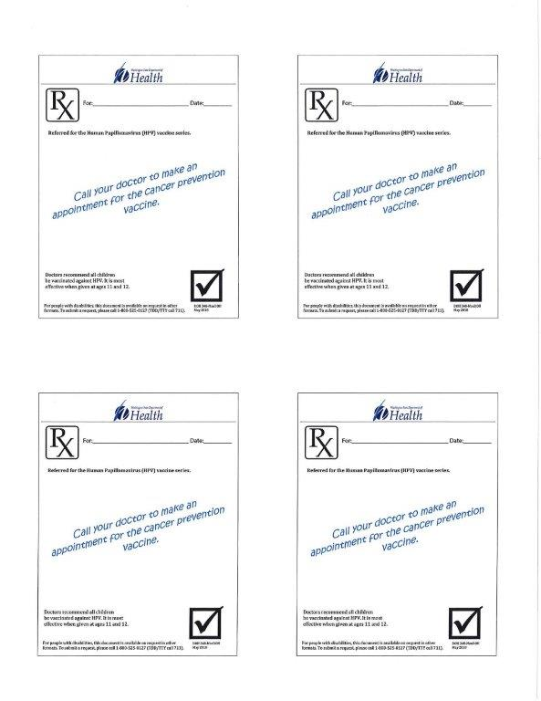
HPV Scripts
Notes:
The prescription sheets are easy handouts to give to patients and parents as a handy reminder to get vaccinated.

Slide 33
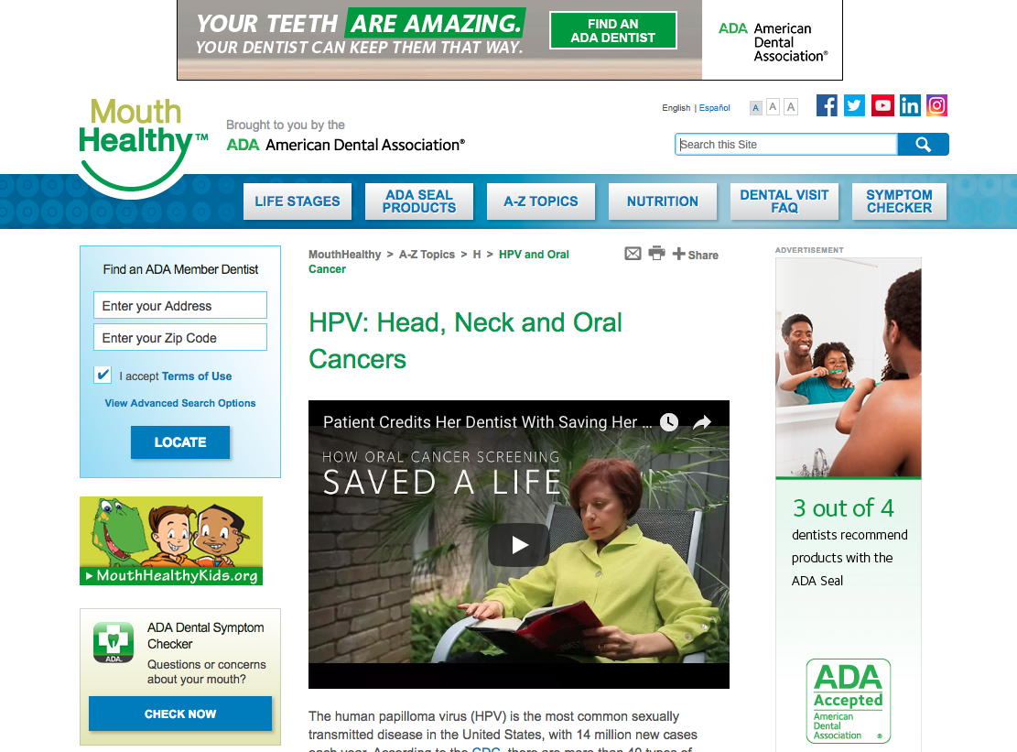
Brought to you by the ADA
Notes:
Through their Website the ADA is actively promoting increased screening of Oral and Oropharyngeal cancers and education regarding the vaccines to the general public.

Slide 34

Questions?
Notes:
(Kelly to end) Thank you for allowing Susan and I to speak to you about disease prevention that we are passionate about.
We ask that our dental partners “Get Mouthy and speak up about oral cancer.”
Do any of you have any questions?

Slide 35
Contact Information
Susan Babcock, RN, BSN
Immunization Public Health Nurse
sbabcock@snohd.org
Kelly Barrows
Vaccines for Children Compliance Coordinator
kbarrows@snohd.org

Slide 36
Special Thanks!
David Bradberry, DMD, FAAPD
Pediatric Dentist
drbradberry@bellsouth.net
For use of slide content
Paul Benedict
HPV related OPC survivor and an amazing advocate

Slide 37
Paul’s Story…
https://youtu.be/2h4LRaxJddk

Slide 38


Paul Benedict-Survivor
Notes:
And now we turn the presentation over to our friend and HPV survivor Paul Benedict to tell you his story.

Slide 39
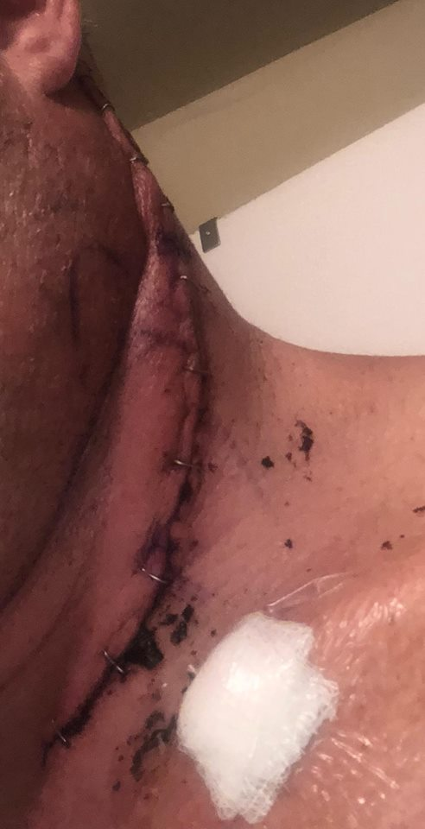
June Surgery

Slide 40
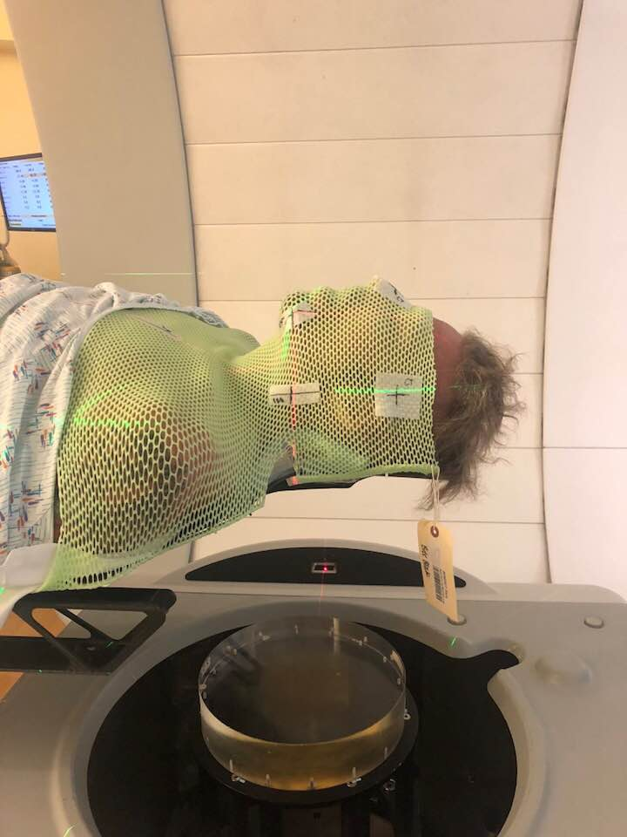
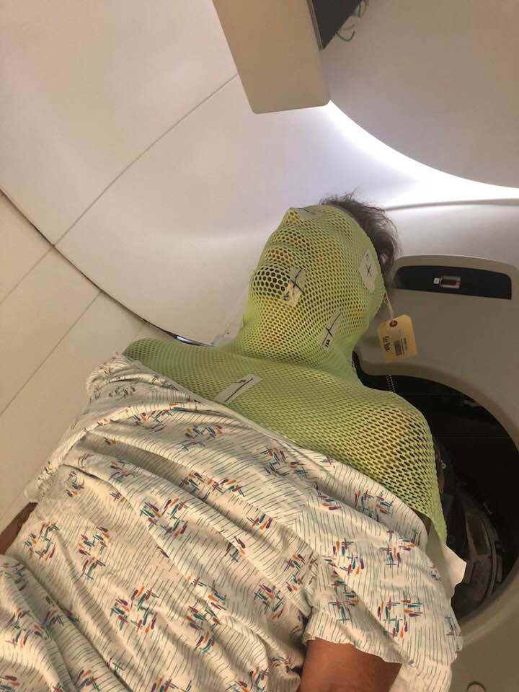
Aug. 14 Proton Radiation Therapy

Slide 41
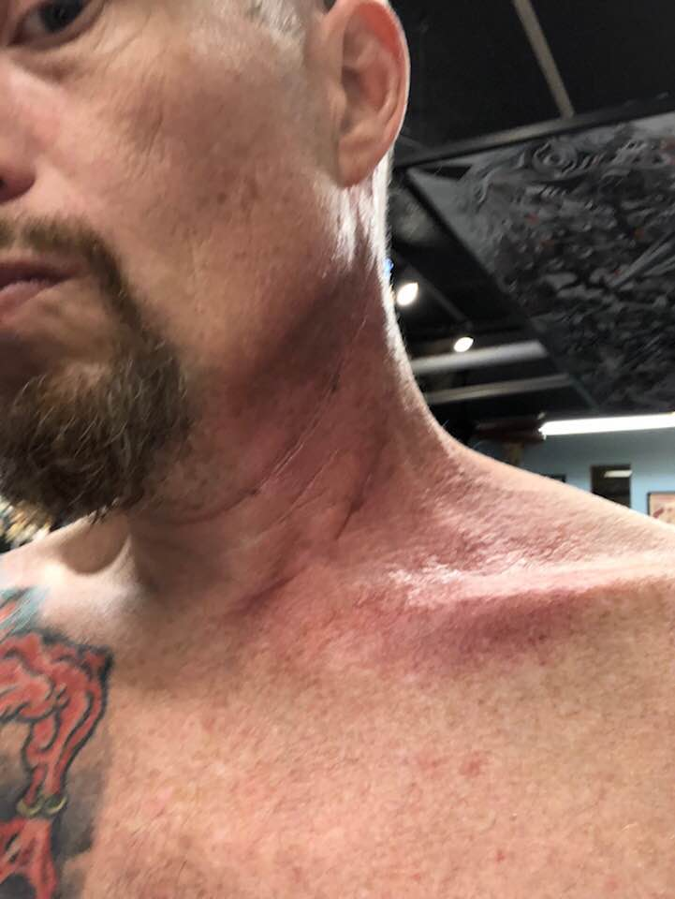
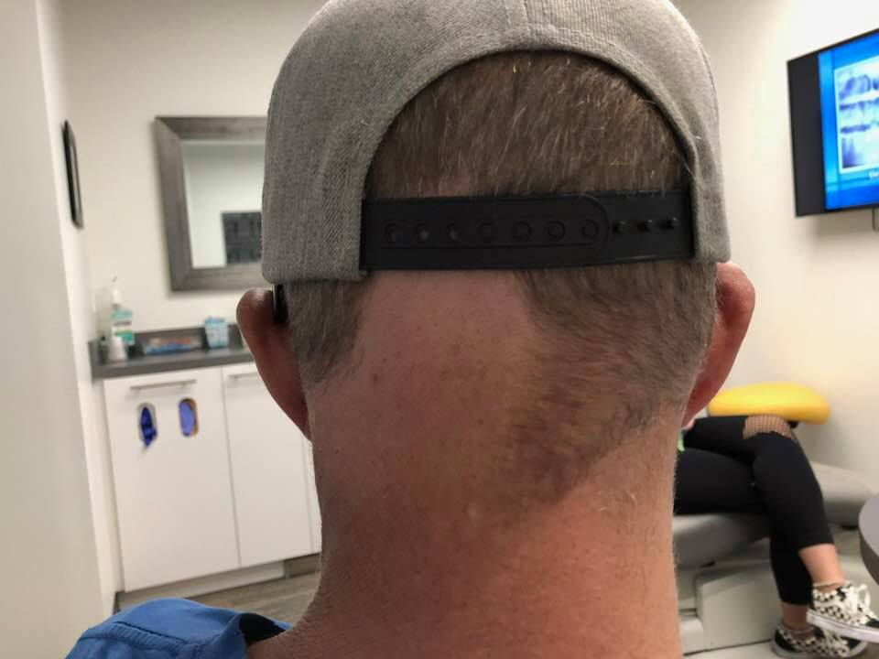
Radiation Burns

Slide 42
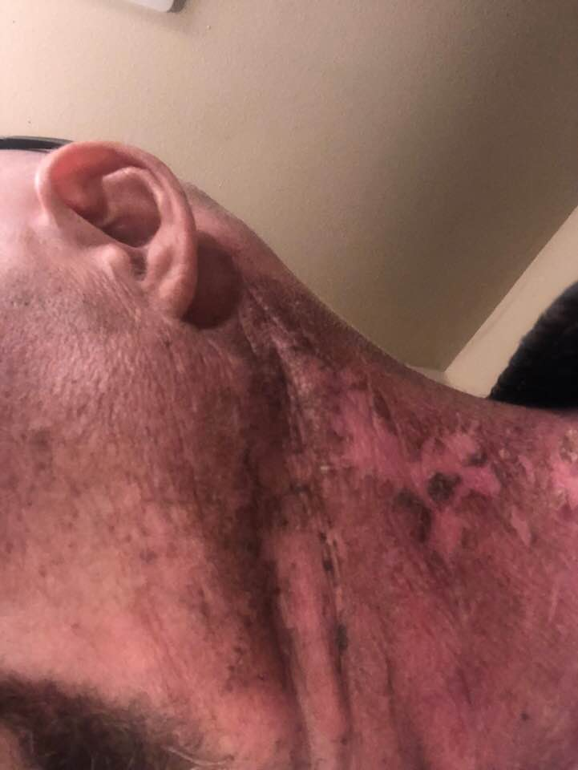
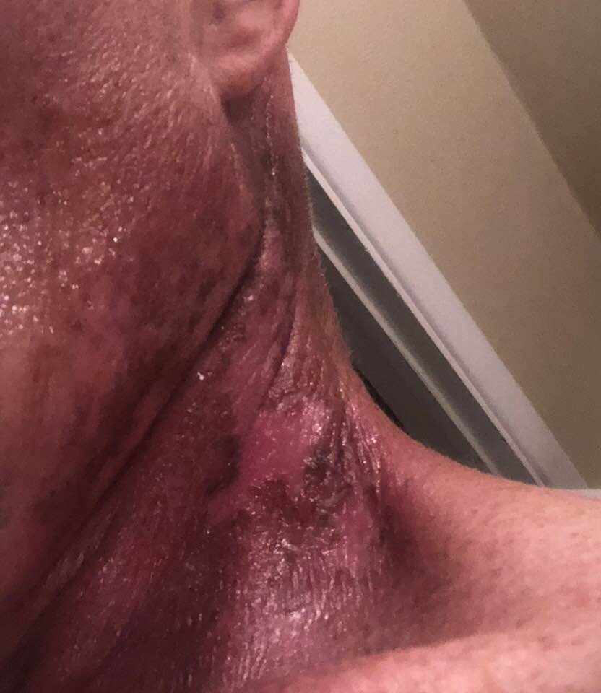
August 26 Radiation Burns

Slide 43

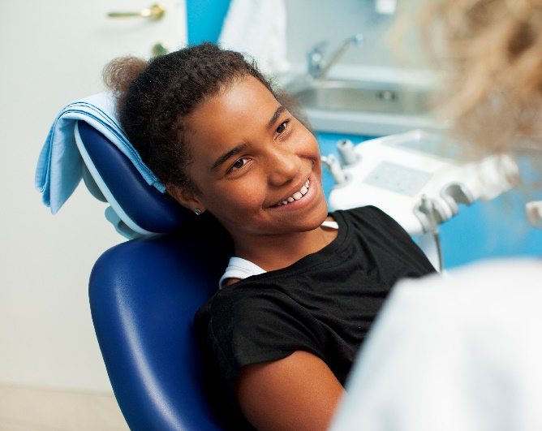
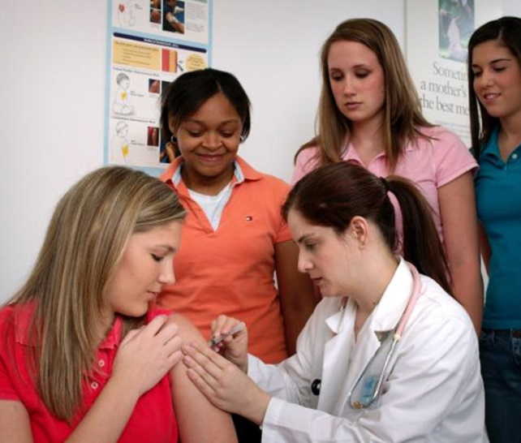
Thank you!

