Slide 1
“Beating the Odds with HPV Vaccines!”
Gretel Page, RN, BSN, PCCN
Bettina Kabachis, CMA
Rob McChesney, MBA
LeCola Phillips, BSHA

Slide 2
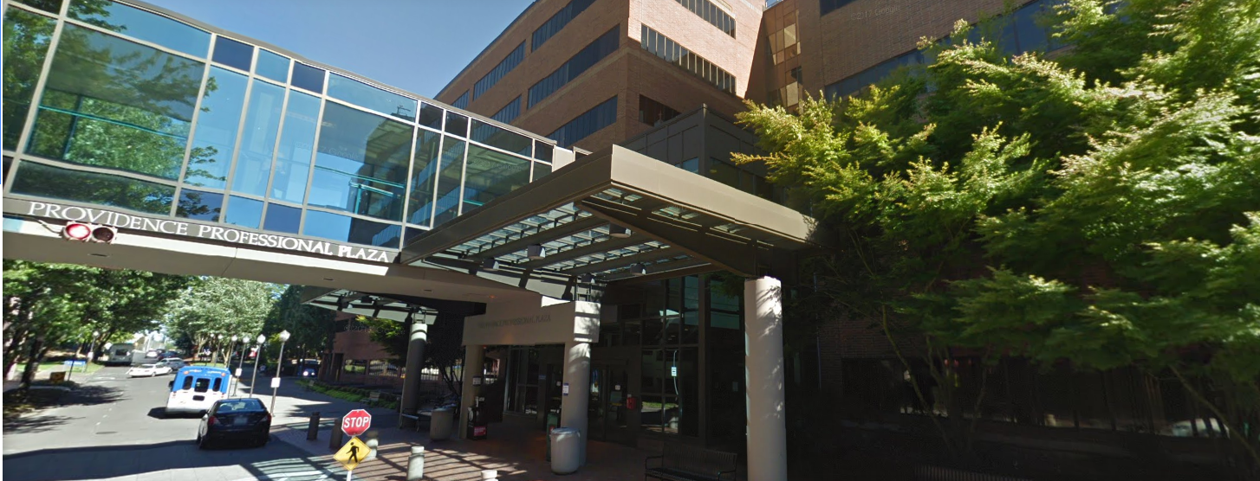
Notes:
https://oregon.providence.org/location-directory/p/providence-medical-group-cascade/

Slide 3
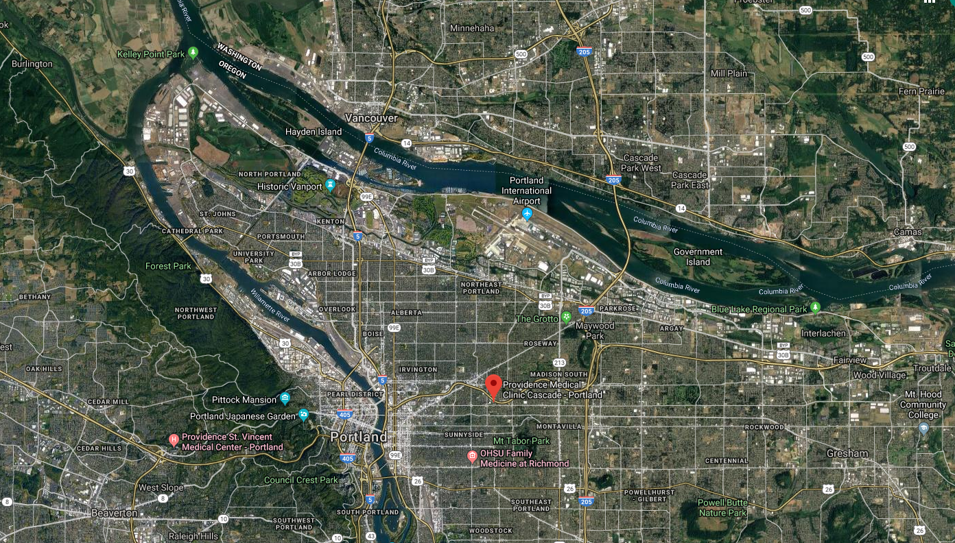
Our Location Matters!
Notes:
We are located in N. Tabor Neighborhood in-between I-5 & I-205 right off of I-84. Our location draws a vast variety of patients from Clark County Washington, Clackamas/Washington County Oregon. Our Medical Office Building is also host to a variety of ancillary services. This draws a lot of families to our clinic! We are located next to a main hospital campus, parking, and mass transit access make us a preferable location to seek primary care services.
https://oregon.providence.org/location-directory/p/providence-medical-group-cascade/

Slide 4
Providence Medical Group Cascade
PROVIDERS
9 Physicians (MD)
3 Physician Assistants (PA-C)
1 Clinical Pharmacists (Phar.D.)
1 Behavioral Health Psychologist (Ph.D.)
CLINIC SUPPORT TEAM
1 Nurse Quality Supervisor (BSN)
1 Nurse Case Manager (BSN)
1 Social Worker Outreach Team Member (MSW)
1 Clinic Nurse (RN)
3 Clinical Care Coordinators (CMA)
9 Medical Assistants (CMA)
10 Patient Relations Representatives
Notes:
14 Providers / 26 Support Team Members / 3 Administrators 2 Supervisors, 1 Manager.

Slide 5
Additional PMG-Cascade Background
Tier 4 Patient Centered Medical Home (Primary Care Clinic)
Comprehensive Primary Care Plus (CPC+) Track 1 Participant.
We understand our data! We regularly utilize team huddle boards, data dashboards (Tableau), and our Electronic Health Record (EPIC) to track and manage our patient population.

Slide 6
HPV Vaccine Best Practices
HPV vaccines effectiveness in prevention of HPV infection and HPV associated cancers.
Recommendations:
HPV vaccination at age 11 or 12 years
Females: Vaccination through 26 years of age
Males: Vaccination through 21 years of age
Dosing Schedule:
Initiation of vaccine prior to 15th birthday – 2 doses of vaccines
The second dose should be administered 6-12 months after the first dose (0, 6-12 month schedule)

Slide 7
Quality Rate Improvement – The 3 P’s
Passion
The initiative behind the story
https://hpvepidemic.vhx.tv/videos/trailer-someone-you-love-the-hpv-epidemic
Proactivity
The people who will participate in the project – Champion Lead, Providers, & Staff members.
Perseverance
The reinforcement of the project
Revisiting the progress of the project

Slide 8
Providence Medical Group – Cascade Family Medicine
Know Your Rates
PMG Cascade Family Medicine 1st Quarter HPV vaccine rate: January 2018 – April 2018
54% of patients between the ages of 13-18 received the HPV Vaccines in the clinic.
64% of the patients returned for the 2nd dose of the HPV vaccine series.
Goal: 100% of eligible patients to receive the 2-3 series of vaccines depending on the age.
AFIX Visits - Quality Improvement Action Plan
Current vaccination rate
Goal vaccination rate and strategies: Patients eligible for vaccine, reminder/call process, recommendations and immunization information resources to help answer questions
Follow up visits

Slide 9
Structure of Success - The 3 A’s
Accountability
Setting the goal for the team: Initiatives, Kudos, Awards and Prizes.
Assertiveness
Consistency of the message to patients and parents.
Provider and staff participation
Accessibility
Handout resources
Availability of the vaccines

Slide 10
Our Success
Our providers and care teams are invested provider patient relationship. Our rooming process, and ability to chart scrub create an opportunity for our MD’s to dive into the patient visit, and discuss options available to the patient.
We actively employ a Patient Family Advisory (PFAC) council to seek their feedback in our attempt to improve how we as a clinic communicate and provide care.
We are accustomed to tracking and using our performance metric data to drive operational decisions. We share this openly with all staff, and is called out in team areas.
We have established culture of continuous improvement. Our staff are empowered to develop concepts and engage in projects to streamline workflows and create sustainable solutions.
We are encouraged to cross pollenate ideas/innovations with our sister clinics across multiple regions within the medical group.
Actively engage with resources available to us (Oregon Health Authority).

Slide 11
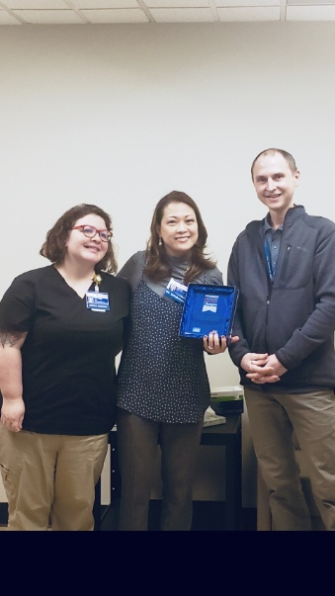
PMG Cascade Family Medicine Success Story!
HPV Vaccination Rate by August of 2018
88% of the eligible patients were vaccinated with the HPV vaccine.
83% of those patients received the 2nd dose of the vaccine.
“2018 HPV Vaccine is Cancer Prevention award Winner”
AFIX Collaboration

Slide 12
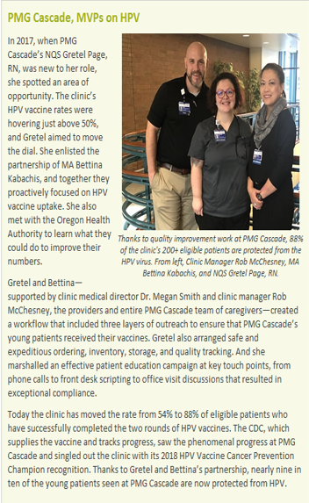
2018 Providence Medical Group Compass Internal Newsletter Announcement
December Issue
As a region, team Cascade was celebrated and asked to share best practice across the region.
Colleagues within the organization often would inquire about workflows, and processes which contributed to the success.
Goal is to spread this recognition to other areas to benefit our patients in the region.
Enormously uplifting for the team to work toward a common goal and receive recognition from the organization. We had generous support & engagement of our providers in the clinic.

Slide 13
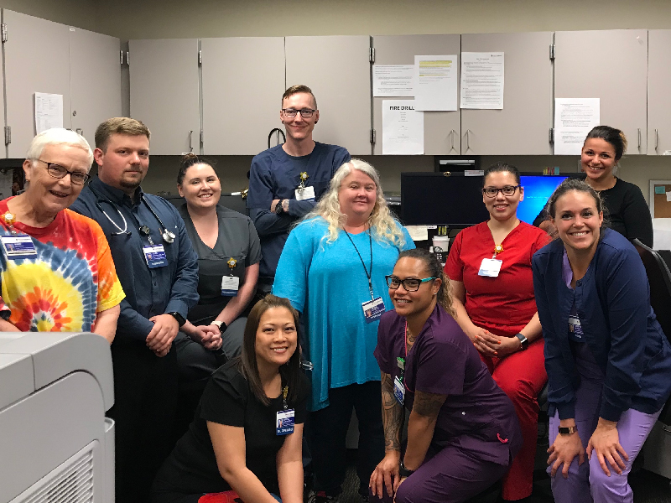
Providence Medical Group, Cascade Family Medicine Portland, OR – CDC Oregon Region Winner
Providence Medical Group, Cascade Family Medicine (Cascade) is one of the original clinics with Providence Medical Group in the Oregon region, with a patient-population of well over 12,000. Cascade participates in an advanced primary care medical home model, which aims to strengthen primary care through regionally based, multi-payer payment reform and care delivery transformation. This creates accountability to make sure patients are up to date with vaccinations, especially with the adolescent patient population.
To ensure that Cascade’s adolescent patients are up to date with vaccines, the clinic created a specific workflow that would guarantee follow up scheduling and completion of the vaccine series. Medical assistant Bettina Kabachis and their Nurse Quality Supervisor, Gretel Page, RN, spearheaded the workflow project. First, a weekly report is created with the names of patients who are due (or overdue) for the HPV vaccine. The medical assistant then calls to schedule a patient visit for the vaccine. If a patient already has an upcoming appointment with a provider, the clinic discusses the HPV vaccine in detail with the parent and patient, and determines whether the patient will receive the vaccine the same day, or in the next 3-6 months. They also schedule the patient for their second HPV vaccine dose 6-12 months out, prior to leaving the clinic.
This workflow has been very effective for Cascade, and speaks to the clinic’s commitment and passion to educate families about the importance of HPV vaccination. The workflow has also given Cascade the title as a Top 10 clinic for completion of the HPV vaccine series in Oregon. These efforts, along with an 88% HPV vaccine completion rate for adolescents, makes Providence Medical Group, Cascade Family Medicine Oregon’s 2018 HPV Vaccine is Cancer Prevention Champion!
CDC- Oregon Region HPV Vaccination Award Winner
https://www.cdc.gov/hpv/champions/2018-winners.html

Slide 14
Questions & Answers?

Slide 15
References
https://www.cdc.gov/vaccines/programs/afix/site-visit-answers.html
https://www.cdc.gov/hpv/hcp/schedules-recommendations.html
https://www.cdc.gov/hpv/champions/2018-winners.html
https://innovation.cms.gov/initiatives/comprehensive-primary-care-plus/
https://www.google.com/maps/place/Providence+Medical+Clinic+Cascade+-+Portland/@45.5168912,-122.7062424,12z/data=!4m5!3m4!1s0x5495a0e0b3ad1449:0xb6305852aaf0192e!8m2!3d45.5267949!4d-122.6116677
https://www.oregon.gov/oha/HPA/dsi-pcpch/Pages/Recognized-Clinics.aspx?wp3432=se:%22Providence+Medical+Group+Cascade%22
https://oregon.providence.org/location-directory/p/providence-medical-group-cascade/

